Slide 1
World Book Day® 2024
Primary school assembly
Subject/theme: Reading for pleasure
Key stage: KS1 and KS2
Age group: 5-11
Notes:
NOTE FOR SPEAKER: All slides with a blue background are instructional and for your use only.

Slide 2
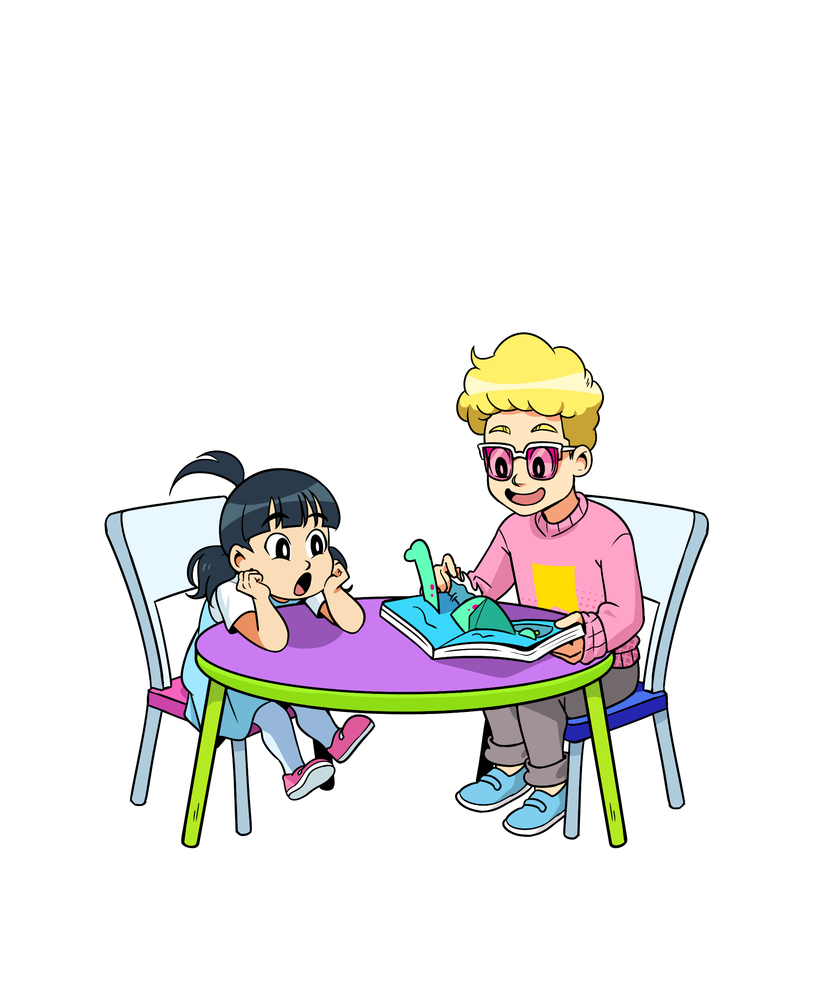
Countdown slides
The next few slides are for your use in the run-up to World Book Day® and across your lessons.

Slide 10
Introduction
Notes:
NOTES FOR SPEAKER: This is a section marker slide

Slide 12
What is World Book Day?
World Book Day is a worldwide celebration of books and reading.
Here are THREE FUN FACTS about World Book Day! Which is your favourite?
The first World Book Day in the UK and Ireland took place in 1997.
Over 2 million £1/€1.50 books are printed, giving children and young people 15 exciting books to choose from and own.
World Book Day wants children to find the books they want to read in their free time.

Slide 13
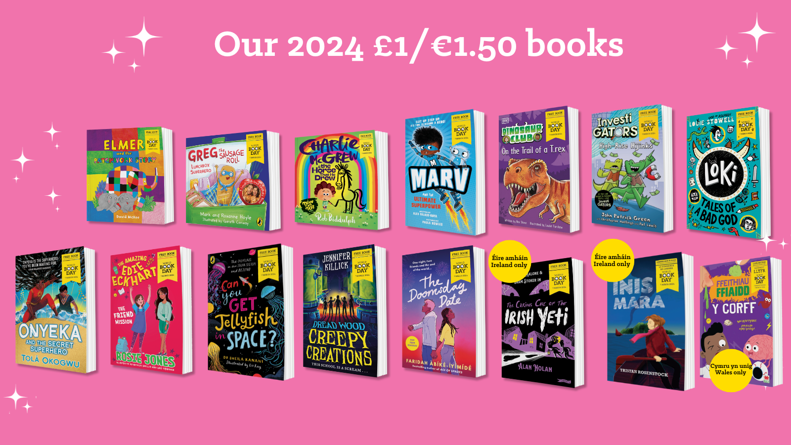
Notes:
NOTES FOR SPEAKER: To celebrate World Book Day, a £1/€1.50 book voucher will be given to every child in the country, including you!
You can take your voucher to a bookshop or supermarket and exchange it for a brand-new book that has been written especially for World Book Day.
In our assembly today, we will be sharing our love of reading and getting to know the authors of this year’s special World Book Day books.
At the end of the assembly, we’ll have a sneaky peak at this year’s World Book Day books so you can think about which one you might like to buy with your £1/€1.50 book voucher!

Slide 14
Child chooses and owns a book
Child goes to bookseller with their token
Bookseller gifts a £1/€1.50 book in exchange for their token
World Book Day £1/€1.50 book tokens distributed by schools/nurseries and our partners
Notes:
NOTES FOR SPEAKER: This slide illustrates the process of getting a book. If you have arrangements in place in school replace with those. A full list of stockist of the World Book Day titles is available here https://www.worldbookday.com/participating-retailers/

Slide 15
Find your reading SUPERPOWER this World Book Day!
'Can I really keep the book?'
Notes:
NOTES FOR SPEAKER – These are World Book Day’s research informed 6 reading behaviours that encourage development of Reading for Pleasure. More detail on this can be found here: https://www.worldbookday.com/about-us/our-approach/. We define Reading for Pleasure as Feeling sense of satisfaction or pleasure by engaging with chosen reading material in their free time. This year World Book Day are asking you to think about Reading your Way – and hope that if you find the right way to read, the right thing to read and the right time and place to do it you’ll find it as it fun hobby. This assembly will give you some ideas.

Slide 16
Find your reading SUPERPOWER this World Book Day!
'Can I really keep the book?'
Notes:
NOTES FOR SPEAKER – These are World Book Day’s research informed 6 reading behaviours that encourage development of Reading for Pleasure. More detail on this can be found here: https://www.worldbookday.com/about-us/our-approach/. We define Reading for Pleasure as Feeling sense of satisfaction or pleasure by engaging with chosen reading material in their free time. This year World Book Day are asking you to think about Reading your Way – and hope that if you find the right way to read, the right thing to read and the right time and place to do it you’ll find it as it fun hobby. This assembly will give you some ideas.

Slide 17
Top tips for enjoying reading!
Notes:
NOTES FOR SPEAKER: This is a section marker slide

Slide 18
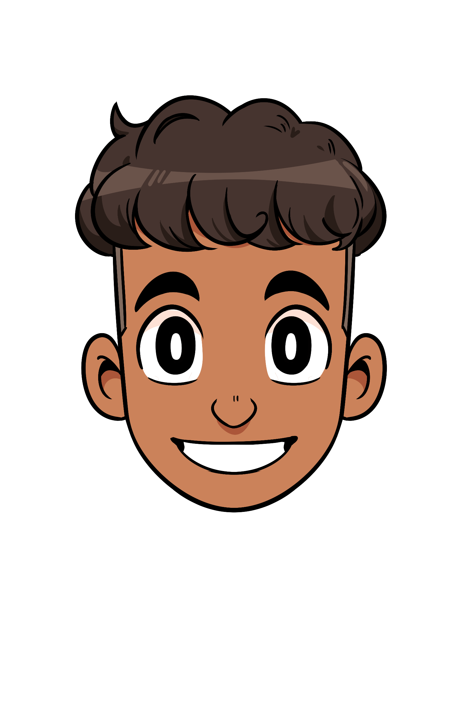
I don’t have enough time
I’m too tired for reading
I have a lot of homework to do
I haven’t found things to read that I like
I get distracted by other things – like games and screens
I don’t like to sit still on my own
Notes:
Notes For Speaker Before we think of some tips for enjoying reading, we might want to think of some things that can get in the way of settling into a new book.
Here are some of the most common reasons! Which of these do you say the most? Can you think of any more to add to the list?

Slide 19
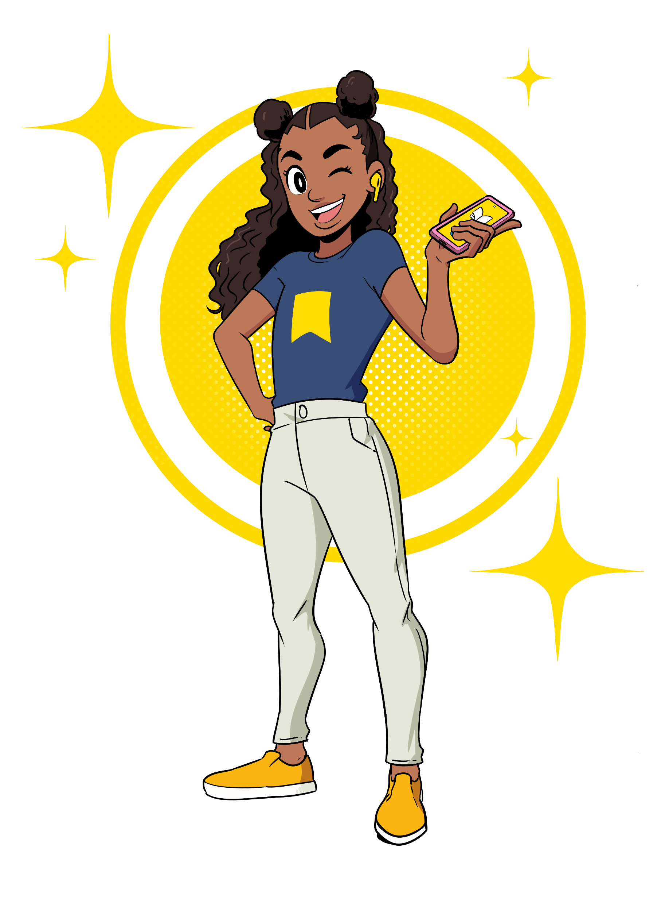
I don’t have enough time
Find quick and easy reads like comics, poems or blogs
Read while you’re on the go! Listen to an audiobook.
“I get distracted by other things – like games and screens”
Sneaky reading – carry something you enjoy reading around with you and see when you can sneak it in – the bus stop, waiting to be picked up, in bed.
Notes:
Now imagine you are giving advice to someone. How would you respond to each of the statements below?
These responses can become your top tips for enjoying reading!

Slide 20
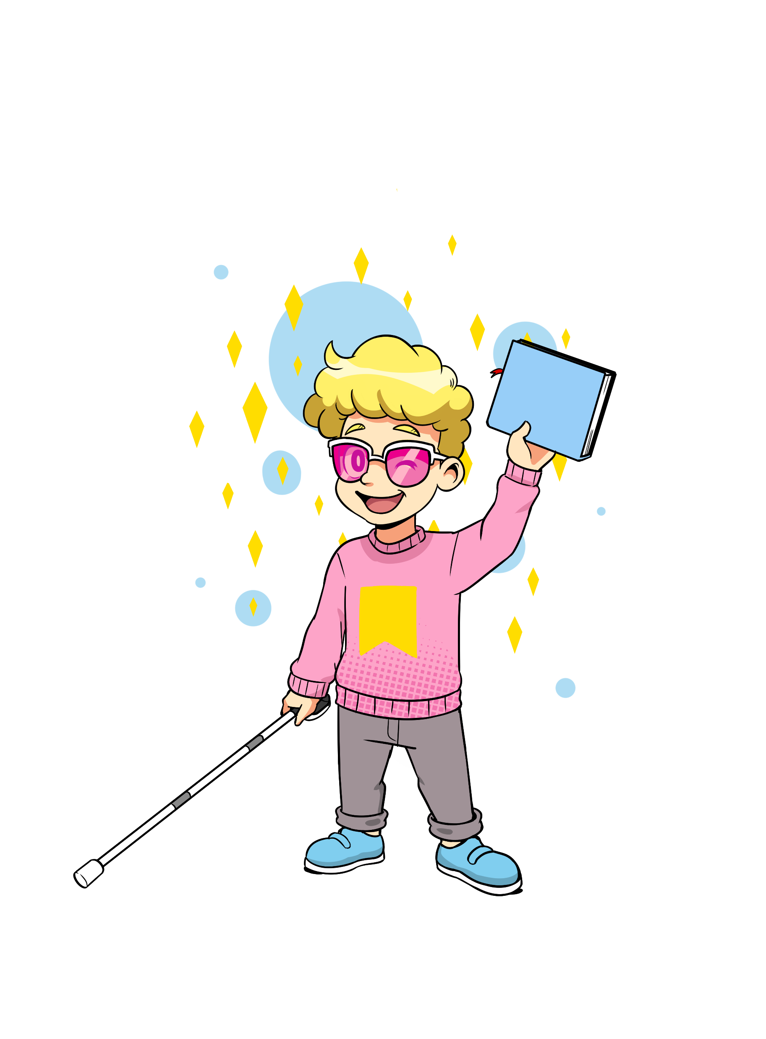
Can you create tips for the other problems?
“I have a lot of homework to do.”
“I get distracted by other things – like games and screens.”
“I don’t like to sit still on my own.”
“I’m too tired for reading.”
"I haven't found things to read that I like."
“I haven’t found things to read that I like”
“I get distracted by other things – like games and screens”
Notes:
NOTES FOR SPEAKER Can you think of some responses to the other statements? This slide is editable so you can add your students feedback to their barriers too.

Slide 21
Let’s hear some top tips for enjoying reading from our wonderful World Book Day authors and illustrators…
SPEAKER- EMBED VIDEO LINK FROM THE TIPS FOR ENJOYING READING PLAYLIST HERE
“I haven’t found things to read that I like”
Our top tip: remember, reading comes in many forms, from audio books to graphic novels, poetry to comics. It can be solitary or social. And you can read wherever you want! Let’s find out more…
Notes:
NOTES FOR SPEAKER: Video playlist for this slide is here https://www.youtube.com/playlist?list=PL_hqLJPmFPST6baPqbQsSyFbafQmAx-2H embed the video/s that you’d like to include from this list. Authorfy has got further options on their website 5 Questions With... - authorfy

Slide 22
You can read anywhere! Where is best for you?
Notes:
NOTES FOR SPEAKER: This is a section marker slide

Slide 23
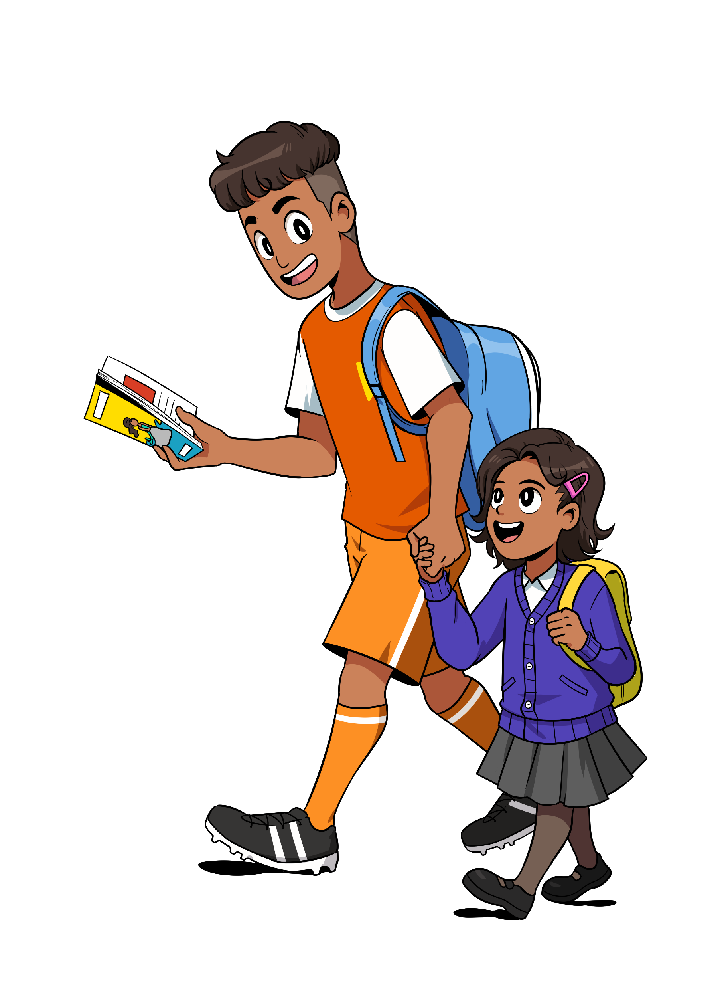
Where is your favourite place to read?
In the park?
In the bath?
While walking the dog?
While doing exercise?
On the toilet?!
Notes:
NOTES FOR SPEAKER: One of the best things about reading is that you can do it anywhere, alone, or with others. Maybe you enjoy reading somewhere familiar, like your bedroom? Or perhaps you like to read with your friends, in a classroom or library? Or do you prefer reading alone on the bus?

Slide 24
What about our wonderful World Book Day authors – where might they enjoy reading? Let’s find out!
SPEAKER- EMBED VIDEO LINK FROM THE WHERE DO YOU ENJOY READING PLAYLIST HERE
“I haven’t found things to read that I like”
Our top tip: when you’re reading in your spare time it doesn’t matter where you are – just make sure it’s a place that makes you feel ready to read.
Notes:
NOTES FOR SPEAKER: Video playlist for this slide is here https://www.youtube.com/playlist?list=PL_hqLJPmFPSR07Lq7MEecLcrM40bZRjB8 embed the video/s that you’d like to include from this list. Our partner Authorfy has got further options on their website 5 Questions With... - authorfy
Did they they share any familiar or unusual places? Did they have anything in common?

Slide 25
Sharing recommendations
Notes:
NOTES FOR SPEAKER: This is a section marker slide

Slide 26
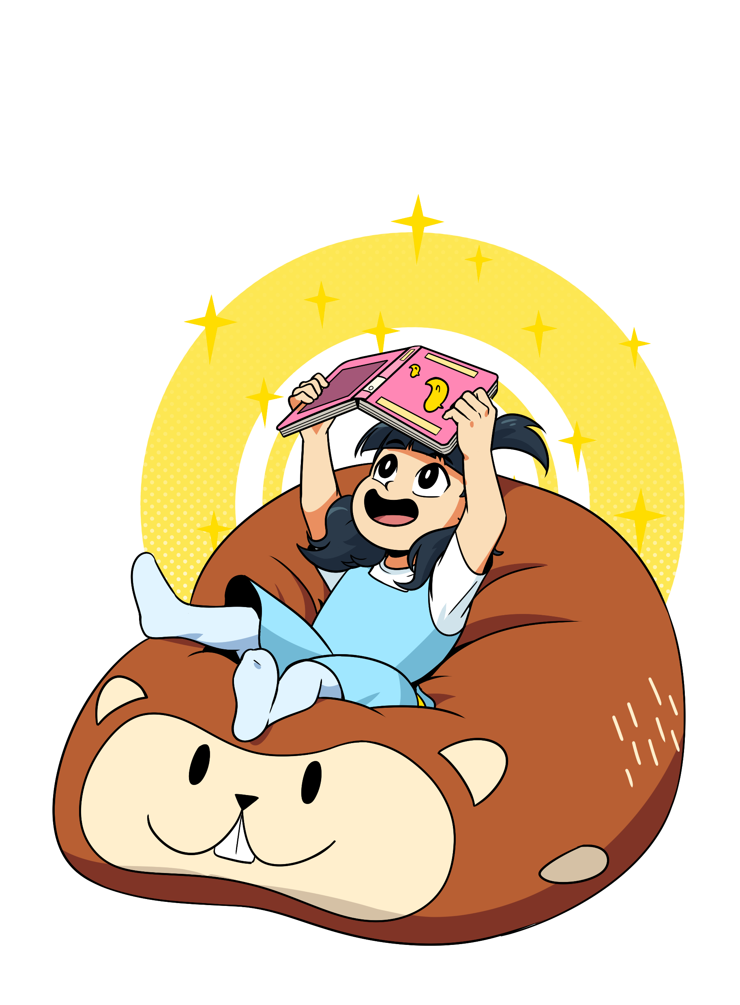
Share something you’ve read in the last year…
I found it very persuasive
Beautiful description
It gave me something to think about
Great characters
It was about something I’m interested in
Great setting
It was addictive!
It made me feel…
It was so funny!
It had wonderful illustrations
Notes:
NOTES FOR SPEAKER Share something interesting you’ve read in the past year with the person sitting next to you. Remember, it can be a book, a graphic novel, an audiobook, a magazine... Use the thought circles to help you share what you liked about it.

Slide 27
What do you want to read more of this year?
Picture books
Poetry books
Adventure books
Comic books
Joke books
Audiobooks
Notes:
We’ve talked about what you’ve read in the last year, but what do you want to read next? There are so many different types of books! Here are just a few. Which would you like to try?

Slide 28
Listen to the World Book Day authors. What have they read, and what do they want to read?
SPEAKER- EMBED VIDEO LINK FROM THE ‘WHAT HAVE YOU READ IN THE LAST YEAR’ PLAYLIST HERE OR USE BOOK JACKETS
“I haven’t found things to read that I like”
Do you feel inspired to read anything that you’ve heard about?
Notes:
NOTES FOR SPEAKER: Video playlist for this slide is herehttps://www.youtube.com/playlist?list=PL_hqLJPmFPSRjKsGt4YvfpAxKOM4v9fwB embed the video/s that you’d like to include from this list. Our partner Authorfy has got further options on their website 5 Questions With... - authorfy

Slide 29
Book recommendation bingo
A book by an author I like | A book recommended to me in this assembly | A book that’s like another one I’ve read
A type of book I’ve never tried before | A book about one of my hobbies or interests | A book that will help me learn to do something new
Notes:
NOTES FOR SPEAKER: Play Book Recommendation Bingo! See if you can find something to fit into all of the categories below. Then pick one to read next.
You can download this as a resource here https://www.worldbookday.com/resource/reading-recommendation-bingo/

Slide 30
Choosing one of this year’s World Book Day books
Notes:
NOTES FOR SPEAKER: This is a section marker slide

Slide 31
Which one catches your eye?
Notes:
SPEAKERS CHOSE FROM :
WHOLE LINE UP IMAGE (ON SLIDE)
OR OUR LAUNCH VIDEO https://www.youtube.com/watch?v=ykNLnXzewOI
OR THE 2024 30 SECOND AUTHOR PLAYLIST https://youtube.com/playlist?list=PL_hqLJPmFPSSfLA_mNT0LWZNWSm0nIwLc&si=kJPB8Zo7yYgpwbkk

Slide 32
Notes:
NOTES FOR SPEAKER: This world book day we hope you find a way to enjoy reading in your spare time that suits you. Happy World Book Day.

Slide 33
Teachers’ notes: suggested follow-on activities
There are four key discussion prompts provided in this assembly. Below are some suggestions of follow-on activities for each one:
1. Top Tips for enjoying reading
Ask children to collate a list of Top Tips for Enjoying Reading to put on display in their classroom or library. They should try to create a list that incorporates everyone’s ideas and points of view.
Encourage children to create a Guidebook for Enjoying Reading to give to their younger peers. Their guidebooks can include pictures and drawings so that they are as persuasive as possible!
Encourage children to spend a moment reflecting individually on why reading is important to them. What are their earliest memories of reading? Why do they think reading is good for them?
Ask children to write a list of ‘I can’ statements about reading. For example: ‘I can find the right book to read, one that matches my interests and hobbies’. These statements should aim to create a positive mindset around books and reading.
Create a Reading Routine template together as a class. When can you find time to read? Where can you read? What kinds of books can you read? Are there opportunities to read together? Encourage children to formulate their own, personal Reading Routines.
Notes:
NOTE FOR SPEAKER: All slides with a blue background are instructional and for your use only.

Slide 34
Suggested follow-on activities contd.
2. You can read anywhere!
Encourage children to keep track of all the places that they manage to read in one week by creating a Reading Map. They might want to think about including conventional and more unconventional places on their map. What was their favourite place to read? Why?
Hold a discussion about how a good reading space makes people feel. In other words, what are the emotions that we need to feel before we can settle into reading?
Ask children to design their dream reading space and share it with the class. What books would they like it to contain? What would they want their dream reading space to feel like?
Discuss whether any of the children’s ‘dream reading space’ design ideas could be incorporated into your school library or class reading sessions.
Reading is a solitary pleasure, but reading in a community makes it even better. Can children think of ways to make reading a shared experience in school?
Notes:
NOTE FOR SPEAKER: All slides with a blue background are instructional and for your use only.

Slide 35
Suggested follow-on activities contd.
3. Share something you’ve enjoyed reading in the past year…
Ask staff to bring in or talk about a book they enjoyed in the past year.
Encourage children to talk to their parents/carers about what books they enjoyed in the past year.
Create an interactive book-share display in your classroom. You could put up pictures of book front covers that children have chosen, adding post-it notes to share their thoughts and responses.
Children could create a concertina booklet entitled ‘My reading journey this year’ filled with pictures and descriptions of significant book memories from the past year. Can they reflect on the different books they have read, and how their tastes have changed or stayed the same?
Create a selection of ‘Book Call Out Cards’ for children to add to favourite books they have read in the library. The cards might say things like ‘This book is very addictive!’ or ‘This book made me feel so happy!’ Children should be encouraged to come up with their own sentences to describe the books they have read. Can they decorate their Call Out Cards with eye-catching designs?
Create a Book Award Ceremony for your students’ recommendations. You can even get dressed up and roll out the red carpet to celebrate kids’ favourites!
Notes:
NOTE FOR SPEAKER: All slides with a blue background are instructional and for your use only.

Slide 36
Suggested follow-on activities contd.
4. What do you want to read more of this year?
Encourage children to keep referring to their Book Recommendation Bingo categories and adding more books as the weeks go by.
Play Book Recommendation Bingo as a class. Use this method to choose new class readers together, building more excitement around the element of choice.
Have a look at the World Book Day website to find out more about this year’s World Book Day £1/€1.50 books. Watch the videos the authors have made about their books and discuss which book the children would like to purchase with their £1/1.50 book token.
Children could create their own ‘Reading Stars’ – i.e. ambitions and reading goals for the future. These goals can be small or large, for example: ‘I want to find a new reading space to enjoy reading’, ‘I would like to read 10 books this year’ or ‘I would like to try an audiobook for the first time.’
Developed with Shapes for Schools and Authorfy.
Notes:
NOTE FOR SPEAKER: All slides with a blue background are instructional and for your use only.

