Slide 1
World Book Day® 2024
Secondary school assembly
Subject/theme: Reading for pleasure
Key stage: KS3
Age group: 11+
This PowerPoint is designed to help you celebrate World Book Day in your secondary school. You will find a range of engaging discussion prompts on the theme of reading for pleasure, plus videos of this year’s World Book Day authors and illustrators sharing their love of reading. The aim is to stimulate book talk and build student’s excitement about reading. This year we are encouraging students to ‘Read your Way’ and discover reading in their own time on their own terms.
You can select which slides you use to curate your own World Book Day celebrations. For example, you might wish to use all the slides from start to finish in your World Book Day assembly. Or you might prefer to use some of the slides in your assembly and use other slides in lessons or form times.
See the Notes section of each slide for a suggested script and more information to help you work with the presentation.
At the end of the pack, you will find ideas for follow-on activities linked to the discussion prompts which can be completed in classrooms.
Developed with Shapes for Schools and Authorfy.
Notes:
NOTE FOR SPEAKER: All slides with an orange background are instructional and for your use only.

Slide 2
Countdown
The next few slides are for your use in the run-up to World Book Day® and across your lessons.
Notes:
NOTE FOR SPEAKER: THIS IS A SECTION MARKER SLIDE

Slide 10
Introduction
Notes:
NOTES FOR SPEAKER: THIS IS A SECTION MARKER SLIDE

Slide 12
What does World Book Day mean to you?
Reflect on the following questions with a partner:
What do you already know about World Book Day?
Have you celebrated it before?
Why do you think it is important to celebrate books and reading?

Slide 13
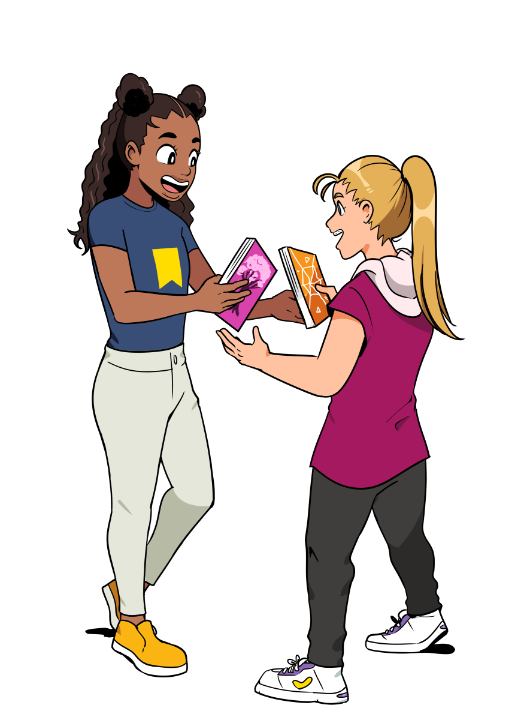
About World Book Day
World Book Day is a worldwide celebration of books and reading.
Here are 3 facts about World Book Day! Do any surprise you?
The first World Book Day in the UK and Ireland took place in 1997.
Over 2 million £1/€1.50 books are printed, giving children and young people 15 exciting books to choose from and own.
World Book Day wants young people to find the books they want to read in their free time.

Slide 14
World Book Day £1/€1.50 books
Notes:
NOTES FOR SPEAKER: To celebrate World Book Day, a £1/€1.50 book voucher will be given to every child in the country, including you!
You can take your voucher to a bookshop or supermarket and exchange it for a brand-new book that has been written especially for World Book Day.
In our assembly today, we will be sharing our love of reading and getting to know the authors of this year’s special World Book Day books.

Slide 15
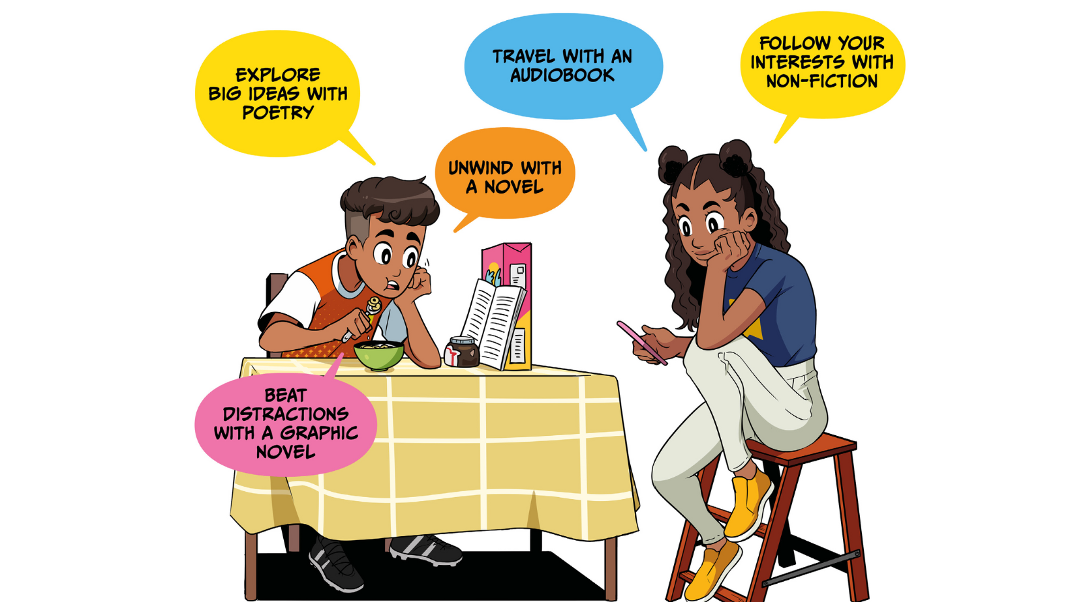
Use World Book Day to support your wellbeing
Notes:
NOTES FOR SPEAKER: This is the same messaging as on the poster. Ask students – which one of these suits your mood today?

Slide 16
Top tips for enjoying reading!
Notes:
NOTES FOR SPEAKER: THIS IS A SECTION MARKER SLIDE

Slide 17
I don’t have enough time
I’m too tired for reading
I don’t like to sit still on my own
I feel intimidated by reading
I get distracted by other things – like games and screens
I have a lot of homework to do
None of my friends read so I don’t want to either
Notes:
Notes For Speaker Before we think of some tips for enjoying reading, we might want to think of some things that can get in the way of settling into a new book.
Here are some of the most common reasons! Which of these do you say the most? Can you think of any more to add to the list?

Slide 18
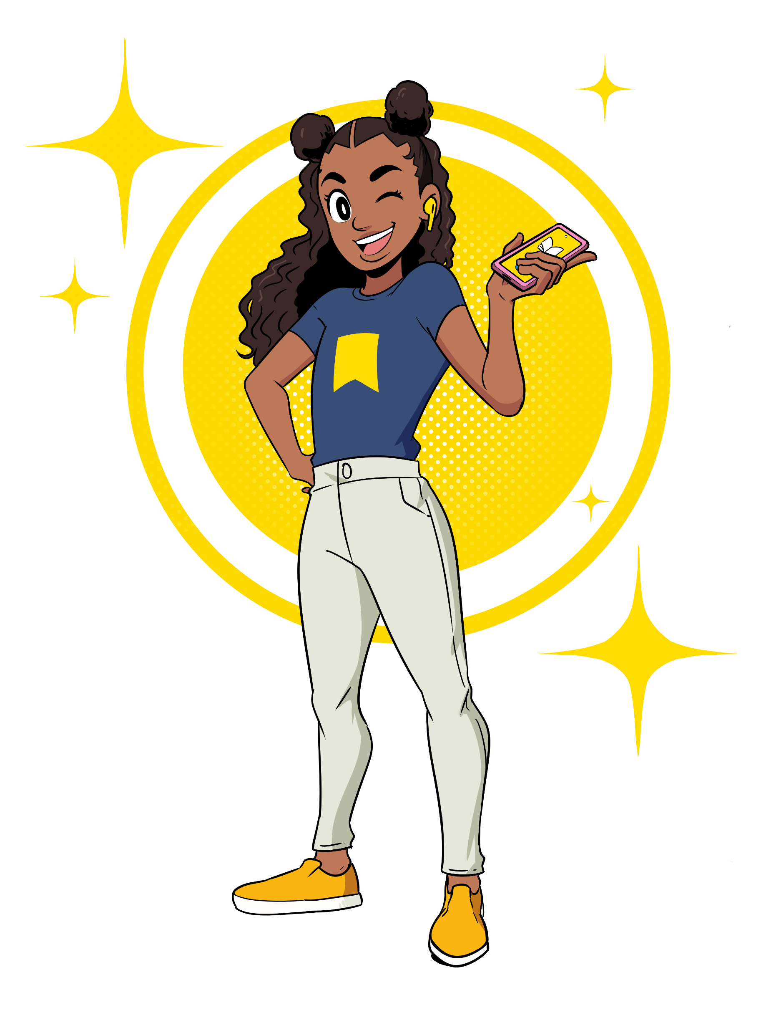
I don’t have enough time
Find quick and easy reads like comics, poems or blogs
Read while you’re on the go! Listen to an audiobook.
“I get distracted by other things – like games and screens”
Creating a time of day to look forward to when you read just for fun, maybe at bedtime or first thing in the morning. Choose the right thing to read to suit your mood that day.
Notes:
SPEAKER NOTES: Now imagine you are giving advice to someone. How would you respond to each of the statements below?
These responses can become your top tips for enjoying reading!

Slide 19
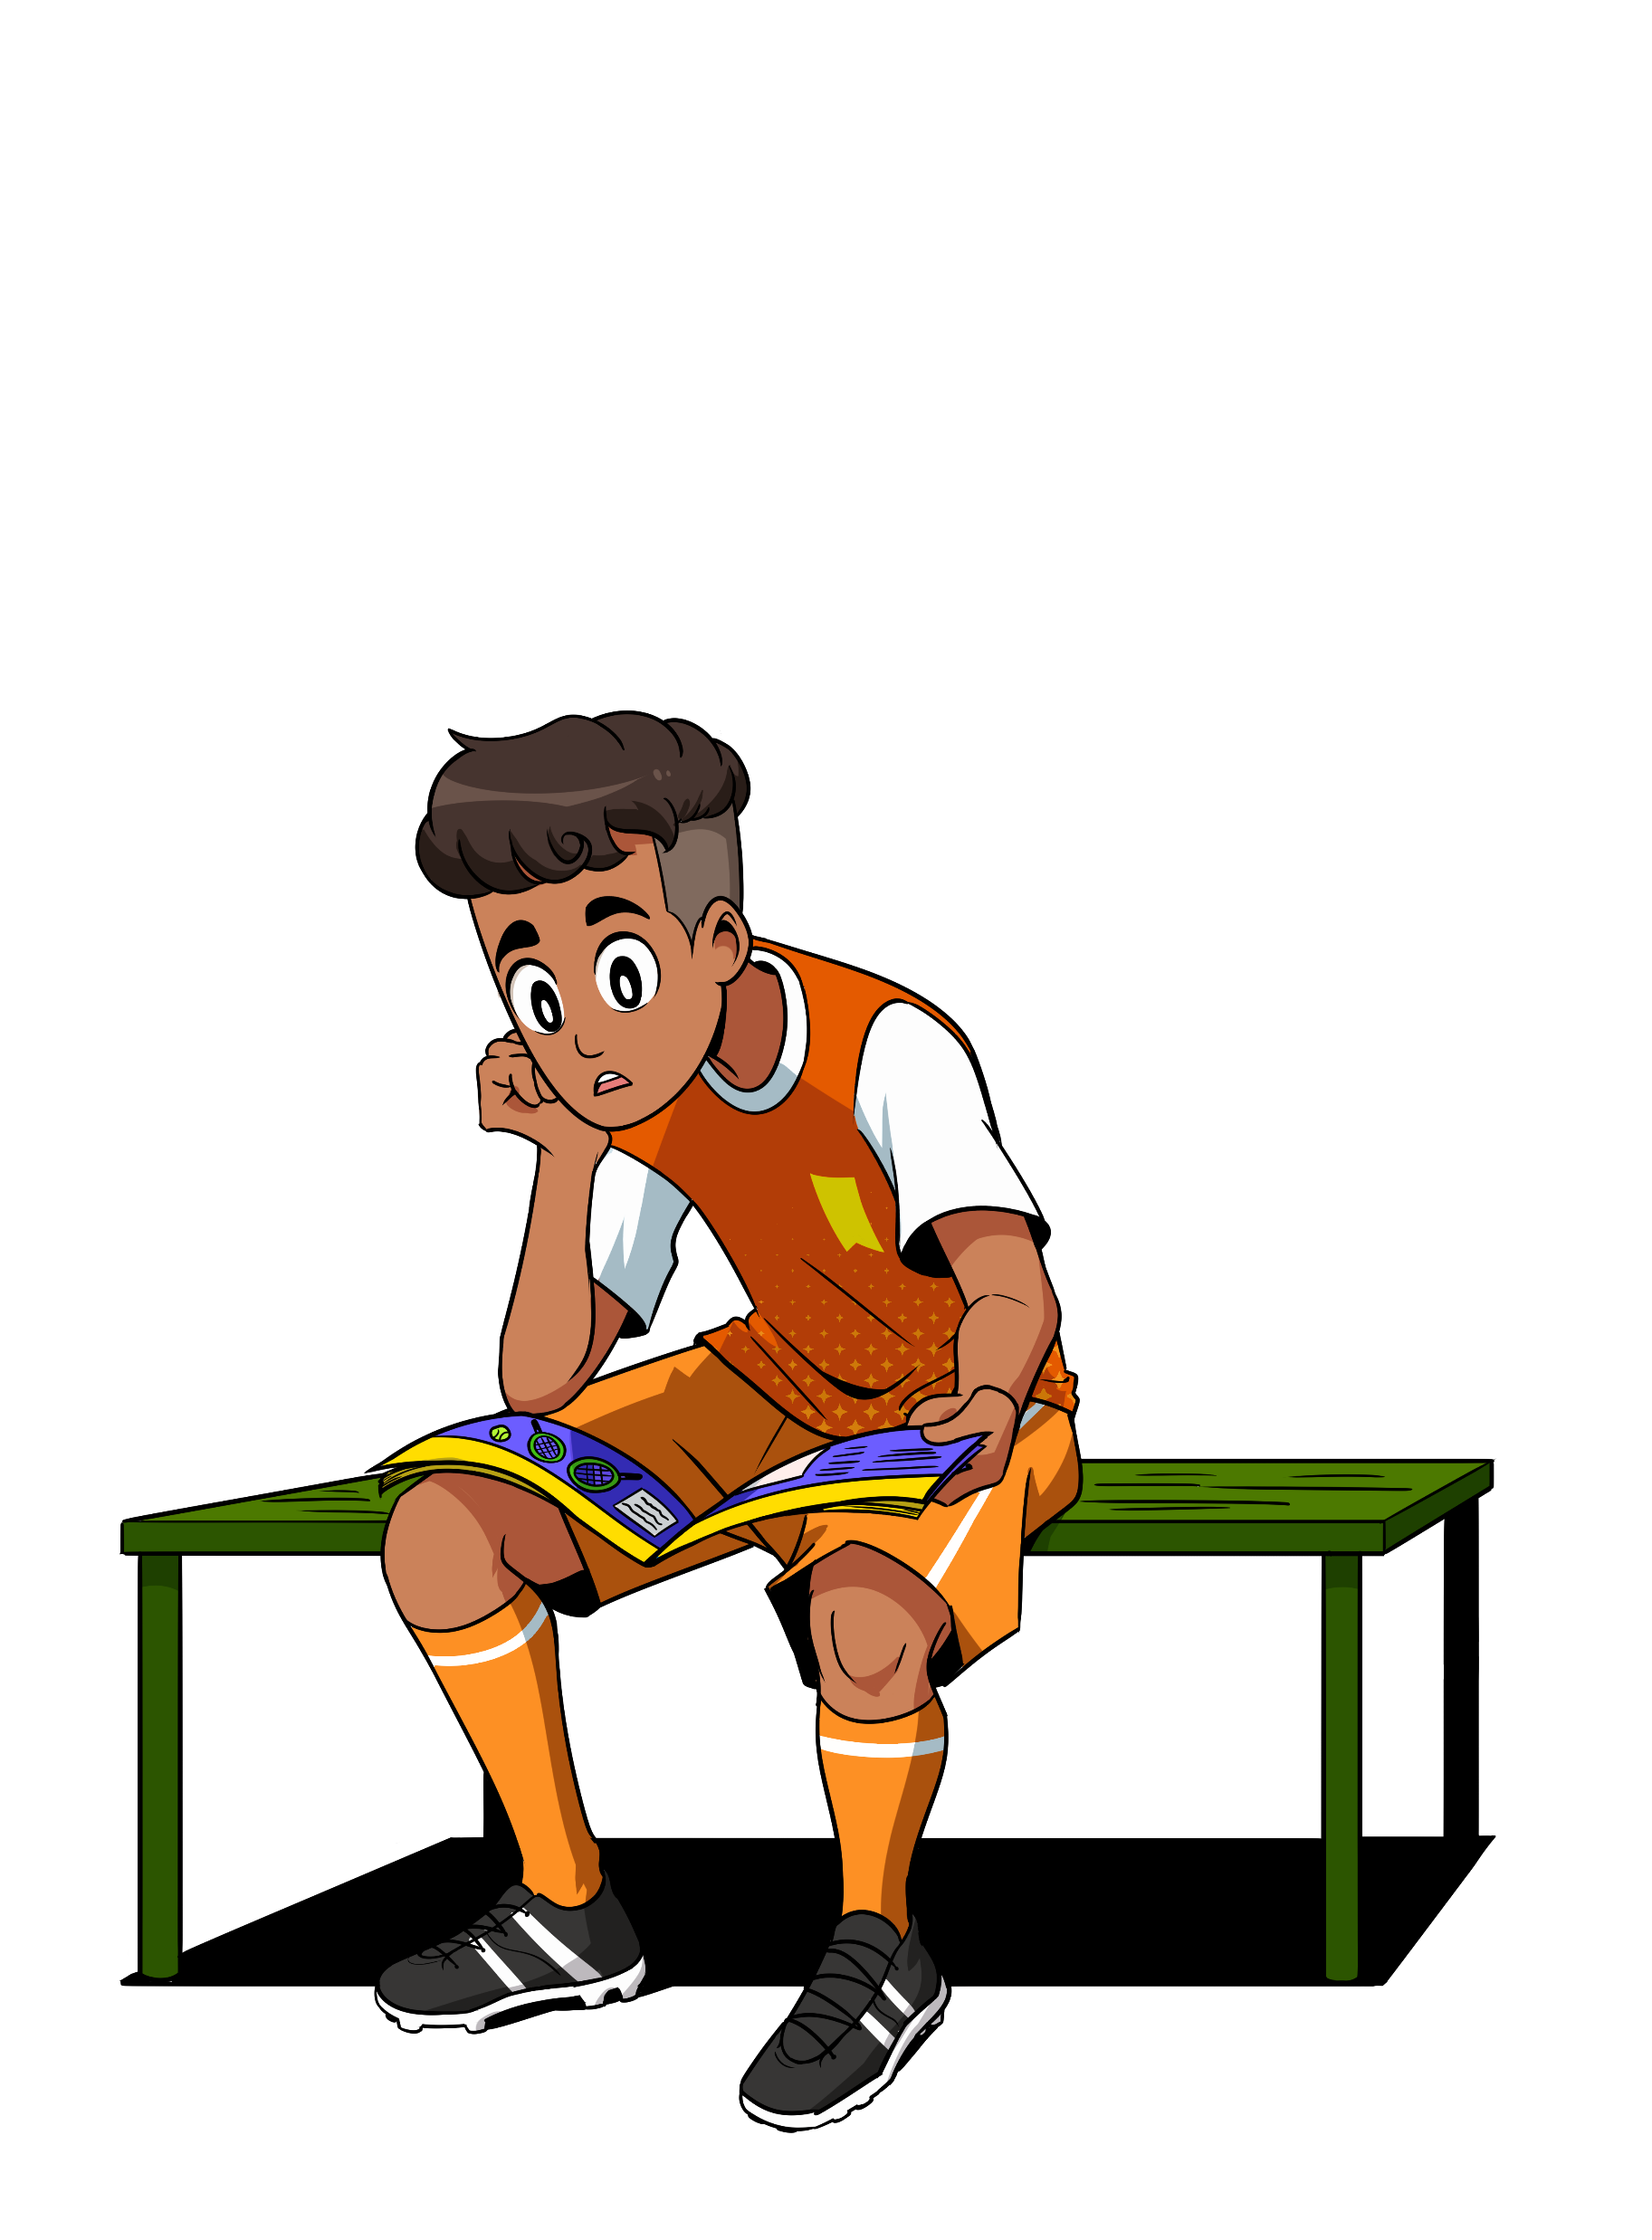
Can you think of some responses to the other statements?
“I have a lot of homework to do.”
“I get distracted by other things – like games and screens.”
“I don’t like to sit still on my own.”
“I’m too tired for reading.”
“I feel intimidated by reading.”
“None of my friends read so I don’t want to either.”
“I haven’t found things to read that I like”
“I get distracted by other things – like games and screens”

Slide 20
Let’s hear some top tips for enjoying reading from our wonderful World Book Day authors…
SPEAKER- EMBED VIDEO LINK FROM THE TIPS FOR ENJOYING READING PLAYLIST HERE
“I haven’t found things to read that I like”
Our top tip: remember, reading comes in many forms, from audiobooks to graphic novels, poetry to comics. It can be solitary or social. And you can read wherever you want! Let’s find out more…
Notes:
NOTES FOR SPEAKER: Video playlist for this slide is here https://www.youtube.com/playlist?list=PL_hqLJPmFPST6baPqbQsSyFbafQmAx-2H embed the video/s that you’d like to include from this list. Authorfy has got further options on their website 5 Questions With... - authorfy

Slide 21
You can read anywhere!
Notes:
NOTES FOR SPEAKER: THIS IS A SECTION MARKER SLIDE

Slide 22
Where is your favourite place to read?
While walking the dog?
On the bus?
In the bath?
While doing exercise?
On the toilet?!
Notes:
NOTES FOR SPEAKER: One of the best things about reading is that you can do it anywhere, alone, or with others. Maybe you enjoy reading somewhere familiar, like your bedroom? Or perhaps you like to read with your friends, in a classroom or library? Or do you prefer reading alone on the bus?

Slide 23
What about our wonderful World Book Day authors – where might they enjoy reading? Let’s find out!
SPEAKER- EMBED VIDEO LINK FROM THE WHERE DO YOU ENJOY READING PLAYLIST HERE
“I haven’t found things to read that I like”
Notes:
NOTES FOR SPEAKER: Video playlist for this slide is here https://www.youtube.com/playlist?list=PL_hqLJPmFPSR07Lq7MEecLcrM40bZRjB8 embed the video/s that you’d like to include from this list. Our partner Authorfy has got further options on their website 5 Questions With... - authorfy
Did they they share any familiar or unusual places? Did they have anything in common?
Did they they share any familiar or unusual places? Did they have anything in common?

Slide 24
Sharing recommendations
Notes:
NOTES FOR SPEAKER: THIS IS A SECTION MARKER SLIDE

Slide 25
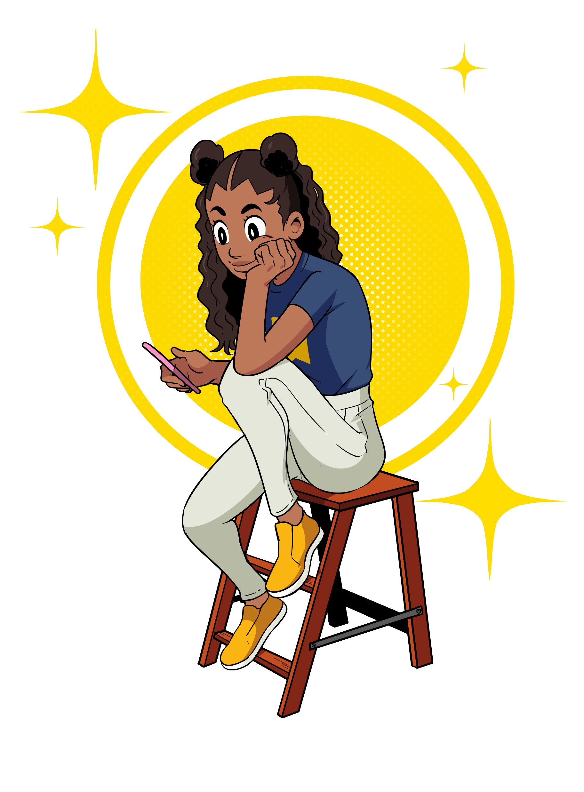
Share something you’ve read in the last year…
Intriguing characters
It was about something I’m interested in
Appealing setting
It was addictive!
Captivating description
It changed my perspective
It was so funny!
It had wonderful illustrations
It made me feel…
Notes:
NOTES FOR SPEAKER Share something interesting you’ve read in the past year with the person sitting next to you. Remember, it can be a book, a graphic novel, an audiobook, a magazine... Use the thought circles to help you share what you liked about it.

Slide 26
What do you want to read more of this year?
Audiobooks
Non-fiction and biographies
YA romance or horror
Adventure books
Poetry books
Graphic novels
Notes:
NOTES FOR SPEAKER: We’ve talked about what you’ve read in the last year, but what do you want to read next? There are so many different types of books! Here are just a few. Which would you like to try?

Slide 27
Listen to the World Book Day authors. What have they read, and what do they want to read?
SPEAKER- EMBED VIDEO LINK FROM THE ‘WHAT HAVE YOU READ IN THE LAST YEAR’ PLAYLIST HERE OR USE BOOK JACKETS
“I haven’t found things to read that I like”
Do you feel inspired to read anything that you’ve heard about?
Notes:
NOTES FOR SPEAKER: Video playlist for this slide is herehttps://www.youtube.com/playlist?list=PL_hqLJPmFPSRjKsGt4YvfpAxKOM4v9fwB embed the video/s that you’d like to include from this list. Our partner Authorfy has got further options on their website 5 Questions With... - authorfy

Slide 28
A book by an author I like | A book recommended to me in this assembly | A book that’s like another one I’ve read
A type of book I’ve never tried before | A book about one of my hobbies or interests | A book that will help me learn to do something new
Notes:
NOTES FOR SPEAKER: See if you can find something to fit into all of the categories. Then pick one to read next.
You can download this as a resource here file:///C:/Users/katew/Downloads/Read-what-I-need-list.pdf/
You can download this as a resource here https://www.worldbookday.com/resource/reading-recommendation-bingo/

Slide 29
Notes:
NOTES FOR SPEAKER: This world book day we hope you find a way to enjoy reading in your spare time that suits you. Happy World Book Day.

Slide 30
Choosing one of this year’s World Book Day books
Notes:
NOTES FOR SPEAKER: THIS IS A SECTION MARKER SLIDE

Slide 31
Which one catches your eye?
Notes:
SPEAKERS CHOOSE FROM :
WHOLE LINE UP IMAGE (THIS IMAGE)
OR THE 2024 30 SECOND AUTHOR PLAYLIST https://youtube.com/playlist?list=PL_hqLJPmFPSSfLA_mNT0LWZNWSm0nIwLc&si=kJPB8Zo7yYgpwbkk

Slide 32
Suggested follow-on activities
There are four key discussion prompts provided in this assembly. Below are some suggestions of follow-on activities for each of the discussion prompts:
1. Top tips for enjoying reading
Encourage students to spend a moment reflecting individually on why reading is important to them. What are their earliest memories of reading? Why do they think reading is good for them?
Ask students to write a list of ‘I can’ statements about reading. For example: ‘I can find the right book to read, one that matches my interests and hobbies’. These statements should aim to create a positive mindset around books and reading.
Using their ideas from the assembly, students can create a poem, rap or song collating their ‘top tips’ for reading.
Hold a discussion about some of the barriers to reading for young people today. Ask students to create a leaflet describing these barriers, tips for how to overcome them, and reasons why this is important.
Encourage students to formulate their own, personal ‘reading routines’. When can they find time to read? Where can they read? Which format of books can they read?
Ask students: if you were running World Book Day next year, how would you encourage more young people to take part and read more books? Can they create a campaign for World Book Day 2025?
Notes:
NOTE FOR SPEAKER: All slides with an orange background are instructional and for your use only.

Slide 33
Suggested follow-on activities contd.
2. You can read anywhere
Challenge students to keep track of all the places they find time to read in a week. Hold an awards ceremony for the strangest or most unique place.
Staff and students can create ‘Masked Reader’ videos of themselves reading in strange or unusual places. Can other students guess each time who the Masked Reader is?
Encourage students to reflect on how the concept of a ‘reading space’ has changed over time. For example, what was a typical place for people to read 100 years ago? How is it different now? What do we need to consider about modern life when we try to find places to read?
Ask students to design a ‘modern reading space’ for the school or local community and present it to their peers. What books would they like their reading space to contain? How would their reading place provide a safe space from the challenges and pressures of modern life?
Can students come up with ideas for how their school can integrate more reading spaces around the building or in classrooms? Create a persuasive campaign to present to school leaders.
Reading is a solitary pleasure, but reading in a community makes it even better. Encourage students to find opportunities to make reading a shared experience in school.
Notes:
NOTE FOR SPEAKER: All slides with an orange background are instructional and for your use only.

Slide 34
Suggested follow-on activities contd.
3. Share something you’ve enjoyed reading in the past year…
Ask staff to bring in or talk about a book they enjoyed in the past year and create a staff bookshelf for students to interact with and choose from.
Encourage students to talk to their parents/carers about what books they enjoyed in the past year.
Create an interactive book-share display in the classroom. Put up pictures of book front covers that students have chosen, adding post-it notes to share their thoughts and responses.
Assign reading ambassadors in each classroom who can gather all the recommendations from their class and share them with another class.
Ask students to think of unique things they have read, not just fiction books, but other day-to-day examples of reading, for example road signs or menus. Share as many of these as possible so that students understand that they are reading all the time.
Create a selection of ‘book call out cards’ for students to add to favourite books they have read in the past year in the library. The cards might say things like ‘This book is very addictive’ or ‘This book made my heart race’. Students should be encouraged to come up with their own sentences to describe the books they have read. Can they decorate their call out cards with eye-catching designs?
Notes:
NOTE FOR SPEAKER: All slides with an orange background are instructional and for your use only.

Slide 35
Suggested follow-on activities contd.
4. What do you want to read more of this year?
Encourage students to keep referring to their book recommendation categories in the assembly and adding more books as the weeks go by. They can even add more categories that are relevant and useful to them, for example: ‘Comforting Reads’, ‘Low Energy Reads’, ‘Speedy Reads’, ‘Stressed-out Reads’.
Students could create their own ambitions and reading goals for the future. These goals can be small or large, for example: ‘I want to find a new reading space to enjoy reading’, ‘I would like to read ten books this year’ or ‘I would like to try an audiobook for the first time.’
Ask students to think about their ideal book. What would it look like? What would it be about? Can they visualise it? Encourage students to complete a creative piece entitled: ‘The Book I Would Love to Read.’ They can draw or describe their ideal book, or both! Students should share their books with each other, their teachers and librarians (who might be able to find it for them)!
Developed with Shapes for Schools and Authorfy.
Notes:
NOTE FOR SPEAKER: All slides with an orange background are instructional and for your use only.

