Slide 1
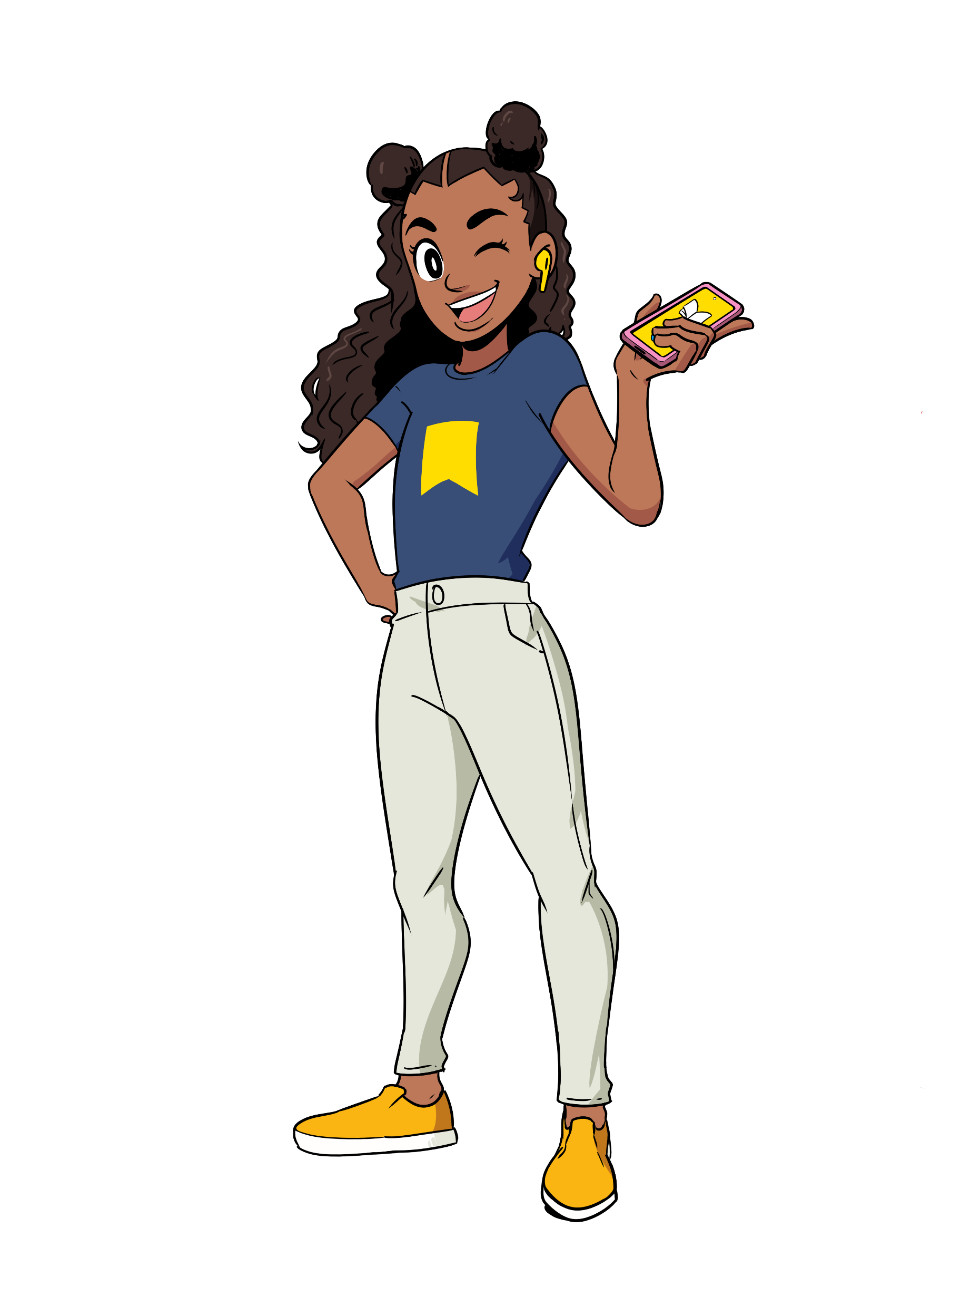
World Book Day® 2024
Secondary Staff briefing
Subject/theme: Using World Book Day to support reading for pleasure
This PowerPoint is designed to help you share the purpose of World Book Day® in your secondary school with fellow staff before you plan your activities. It contains information about the purpose of World Book Day and links to some of our resources.
You can select which slides you use to curate your own World Book Day celebrations, or you might simply want to share the whole presentation for staff to read in their own time. See the ‘Notes’ section of each slide for a suggested script and more information to help you work with the presentation.
Developed with Lit Drive.
Notes:
NOTE FOR SPEAKER: All slides with a blue background are instructional and for your use only.

Slide 2
Countdown and general slides
The next few slides are for your use in the run-up to World Book Day® and across your lessons.

Slide 10
Staff briefing
Notes:
NOTES FOR SPEAKER: This is a section marker slide

Slide 11
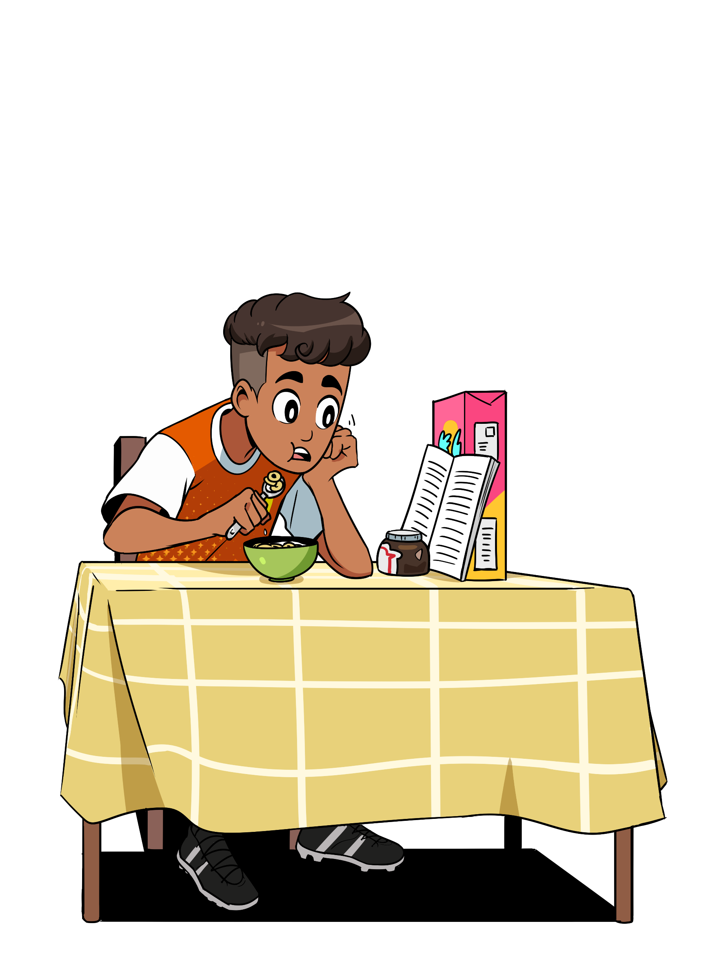
#WorldBookDay
What was the first book you remember enjoying?
Why is it memorable?
Notes:
Display on entry. Encourage staff discussion. Take feedback and focus on the positive memories. The love of stories.

Slide 12
#WorldBookDay
Why do we celebrate World Book Day?
Can you find the false statement?
1 in 14 of all children, 1 in 8 disadvantaged
1 in 8 children don't own a book
Children who own a book are three times more likely to read above age expected level
1 in 5 children receiving free school meals said the book they ‘bought’ with their World Book Day book token was the first book they had of their own
96.9% of children have heard of World Book Day
Around 2 in 5 (43.4%) UK children aged 8 to 11 enjoy reading
51.24 is the average number of books owned by children and young people who say that they have books of their own at home
Reading for pleasure is the single biggest indicator of a child’s future success – more than their family circumstances, their parents’ educational background or their income
Reading for pleasure is one of the most important predictors of test scores at age 16, regardless of background
There is a strong correlation between regular reading for pleasure and mental wellbeing
Reading improves a child’s empathy skills
Notes:
Quick quiz. Deliberately tricky to encourage staff to focus carefully and discuss each piece of information. Highlight the importance of the impact of reading on a child’s future

Slide 13
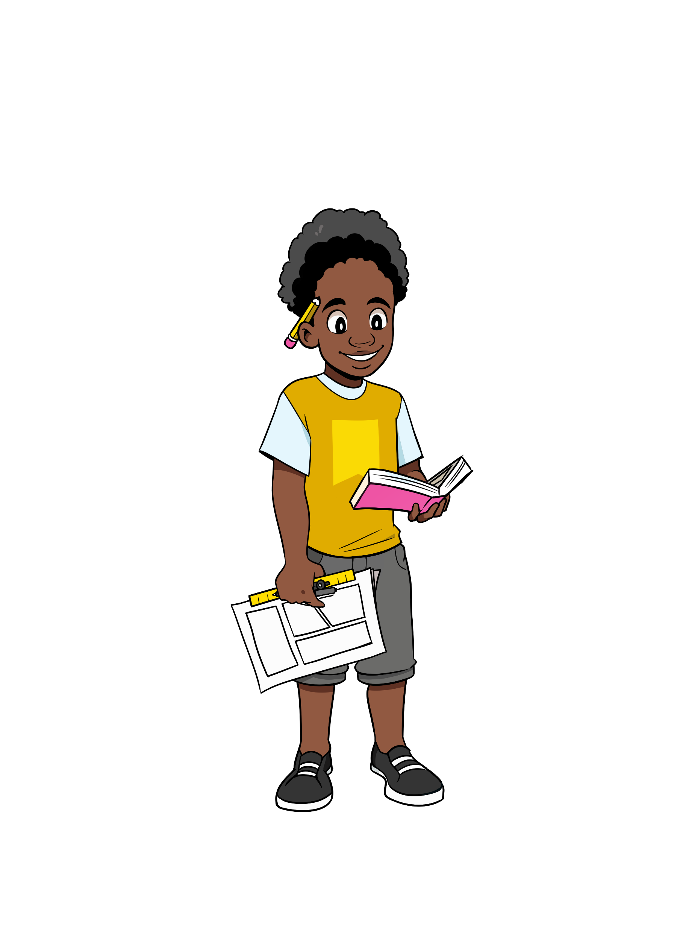
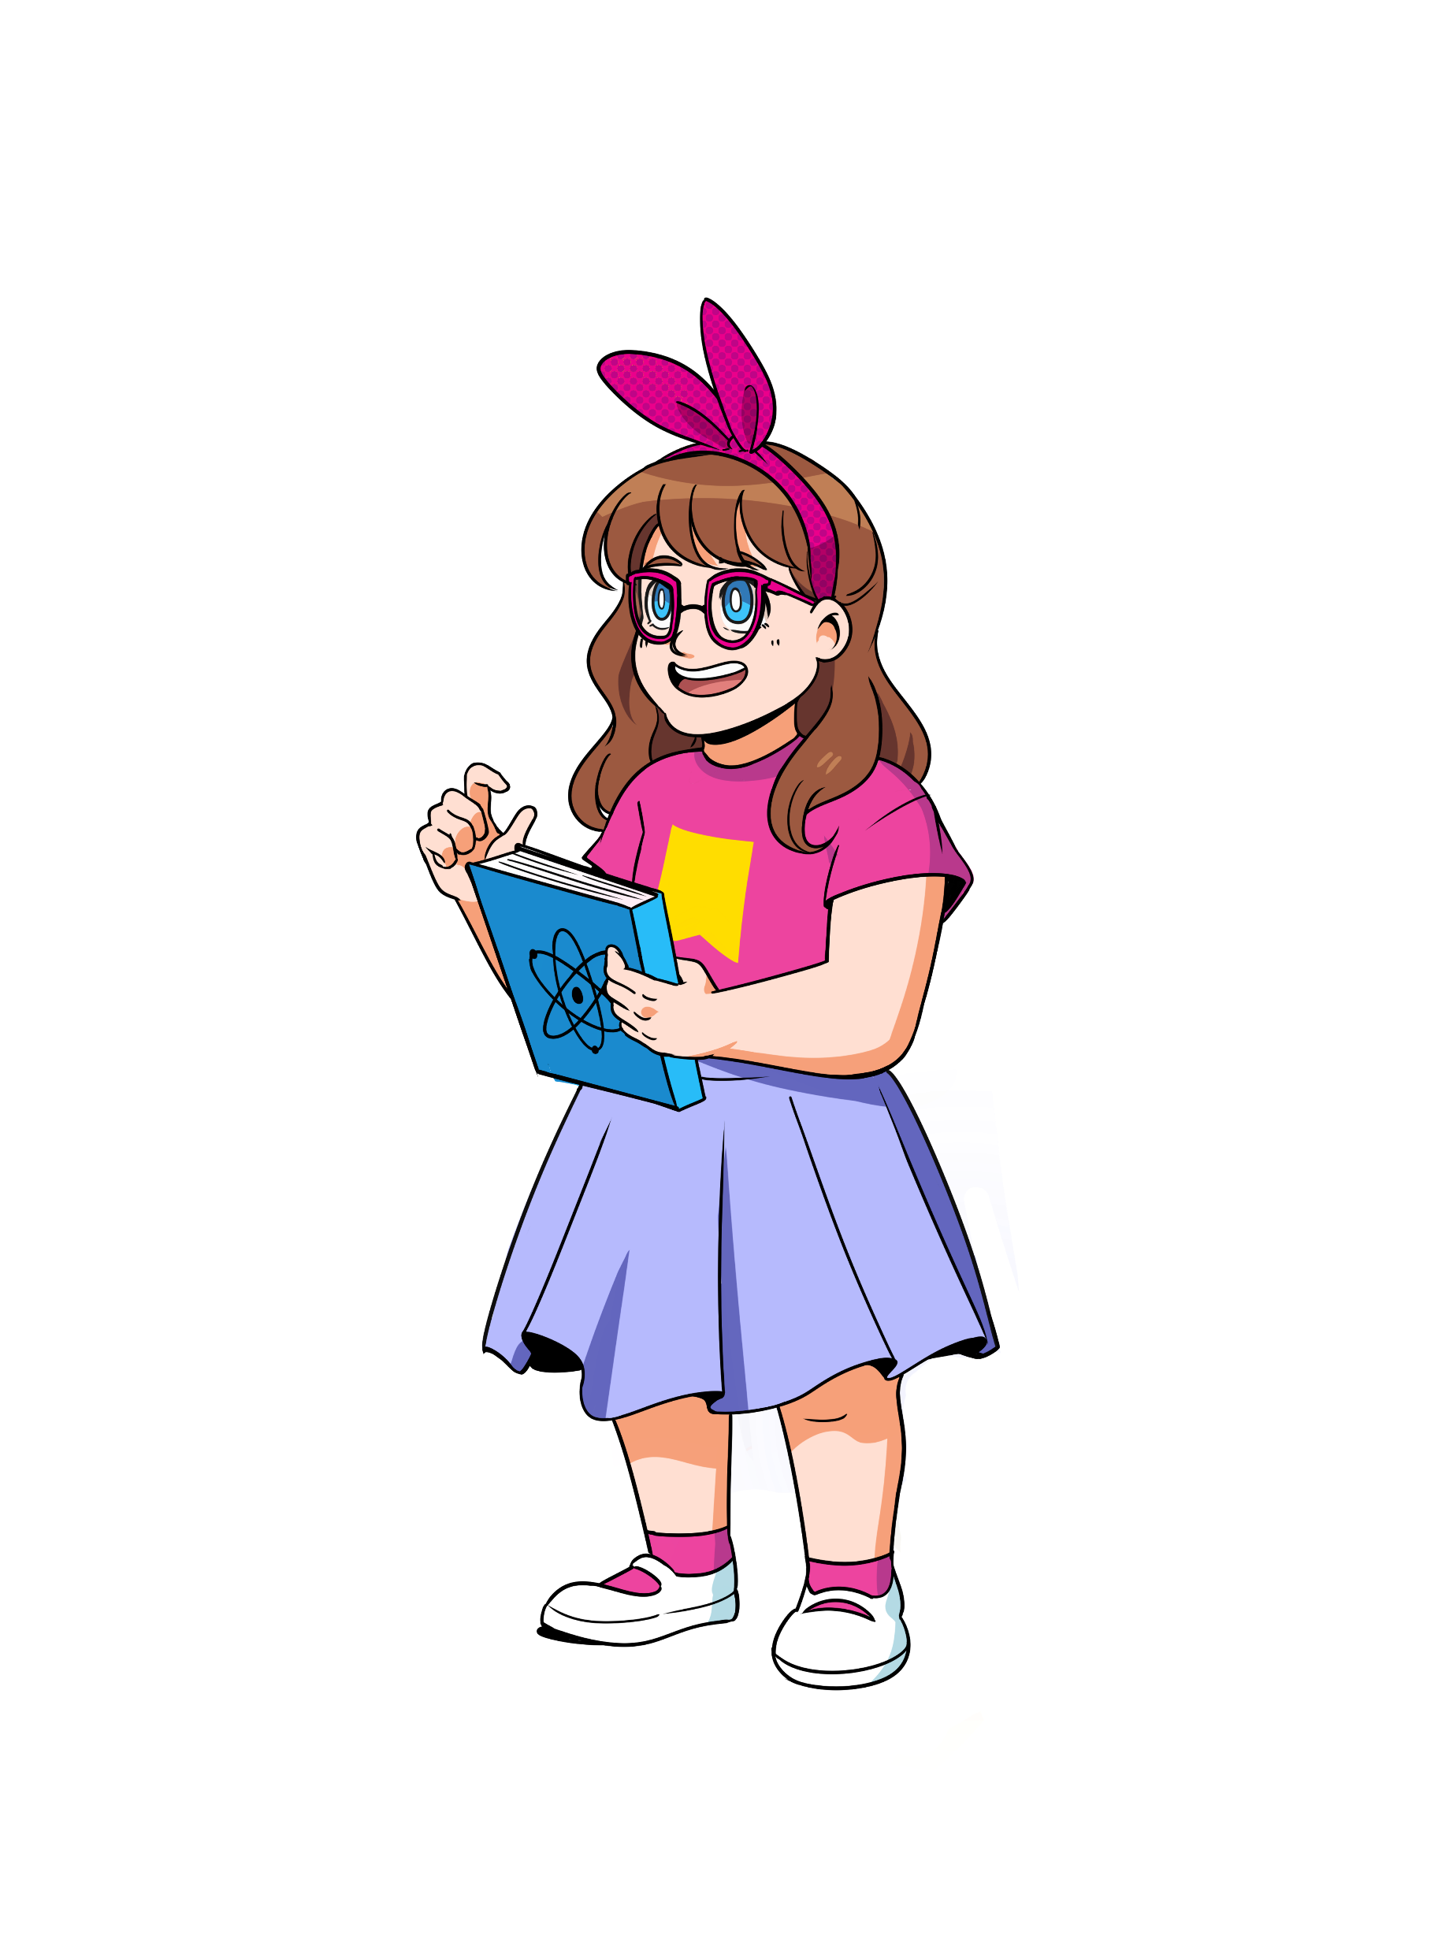
Why do we celebrate World Book Day?
#WorldBookDay
For many children, access to books is a serious issue –
1 in 7 pupils (16.1%) said the book they had ‘bought’ with their World Book Day book token had been their first book of their own. This rises to 1 in 5 (20.7%) for children receiving Free School Meals
Source: 2023 National Literacy Trust, Annual Literacy Survey
'Can I really keep the book?'
Just 2 in 5 (43.4%) children aged 8 to 18 said they enjoyed reading in 2023. This is the lowest level since we first asked the question in 2005.
Source: 2023 National Literacy Trust, Annual Literacy Survey
‘I just want to treasure it because I never get things that are new.’
Notes:
Present the Data and quotations from ‘Exploring the impact of World Book Day on the reading lives of children in the UK 2019-2021’ National Literacy Trust

Slide 14
What children are telling us about reading for pleasure:
We’re told one thing (reading is great!), but are shown another (reading is work).
What does this mean for World Book Day?
This is an opportunity to re-position reading as a hobby
Notes:
NOTES FOR SPEAKER: Research done by World Book Day has identified that students strongly feel that they are being told one thing and shown another around reading. There is a big opportunity to use World Book Day as a way to show them how reading in their spare time can look and feel different to the work of reading in school and to work with students to celebrate home reading.

Slide 15
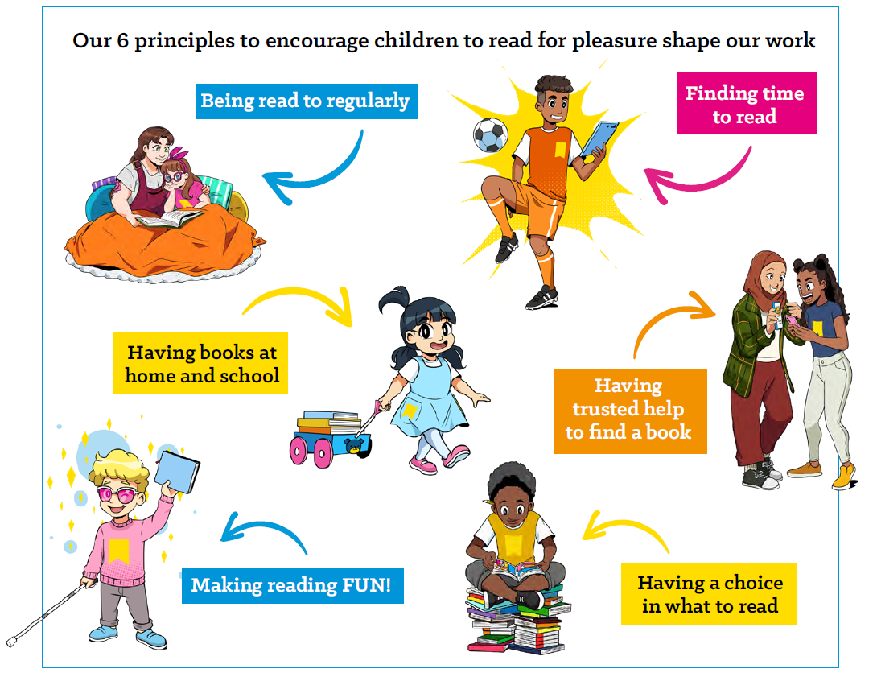
#WorldBookDay

Slide 16
#WorldBookDay
Plan your activities using our ‘reading for pleasure’ audit
Use the table to map the access children have to our six elements at home and at school.
Look at the gaps – how could your World Book Day activity have an impact on these?
How will you communicate your plans to families and include them in your reading community?
 | Being read to regularly | Having books | Having a choice in what you read | Finding time to read | Having trusted help to find a book | Making reading FUN!
At home
At school

Slide 17
#WorldBookDay
Let’s explore the activities linked to the six building elements
https://www.worldbookday.com/celebrate-world-book-day/ https://www.worldbookday.com/our-activity-bank/
https://www.worldbookday.com/educators/
Notes:
Could use a link to the WBD website OR use of handout (schools pack and distribute). Staff discussion: what will work for your subject area? How can we use/adapt the activities? What will we all do?

Slide 18
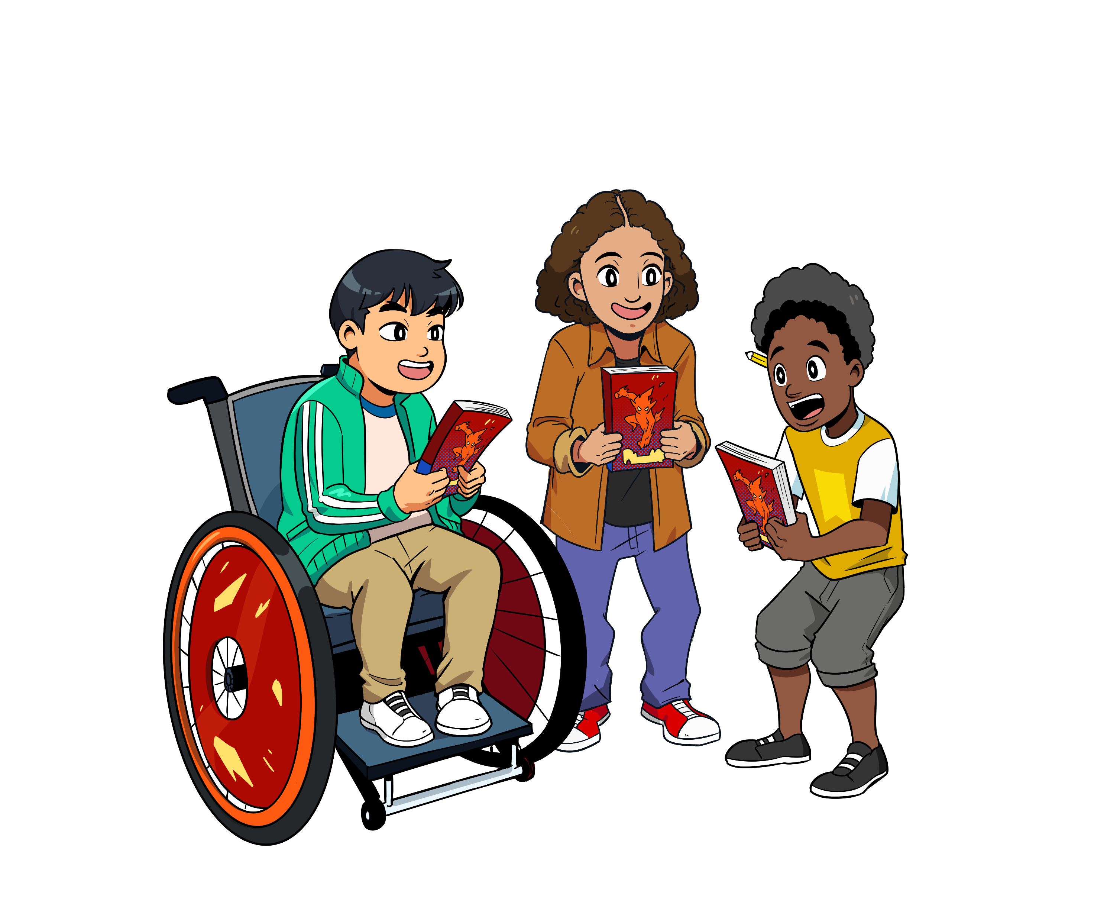
#WorldBookDay
The mission is simple:
To promote reading for pleasure, offering every child and young person the opportunity to have a book of their own.
Notes:
End with a focus on the WBD mission

