Slide 1










BOOKS THAT HELP US TO FEEL
How Reading Supports Our Mental Health
© Jigsaw Education Group
Notes:
Teacher Notes:
Explain that today we are thinking about how stories and reading aren’t just for schoolwork—they’re tools that can support our emotional health and help us feel less alone.

Slide 2


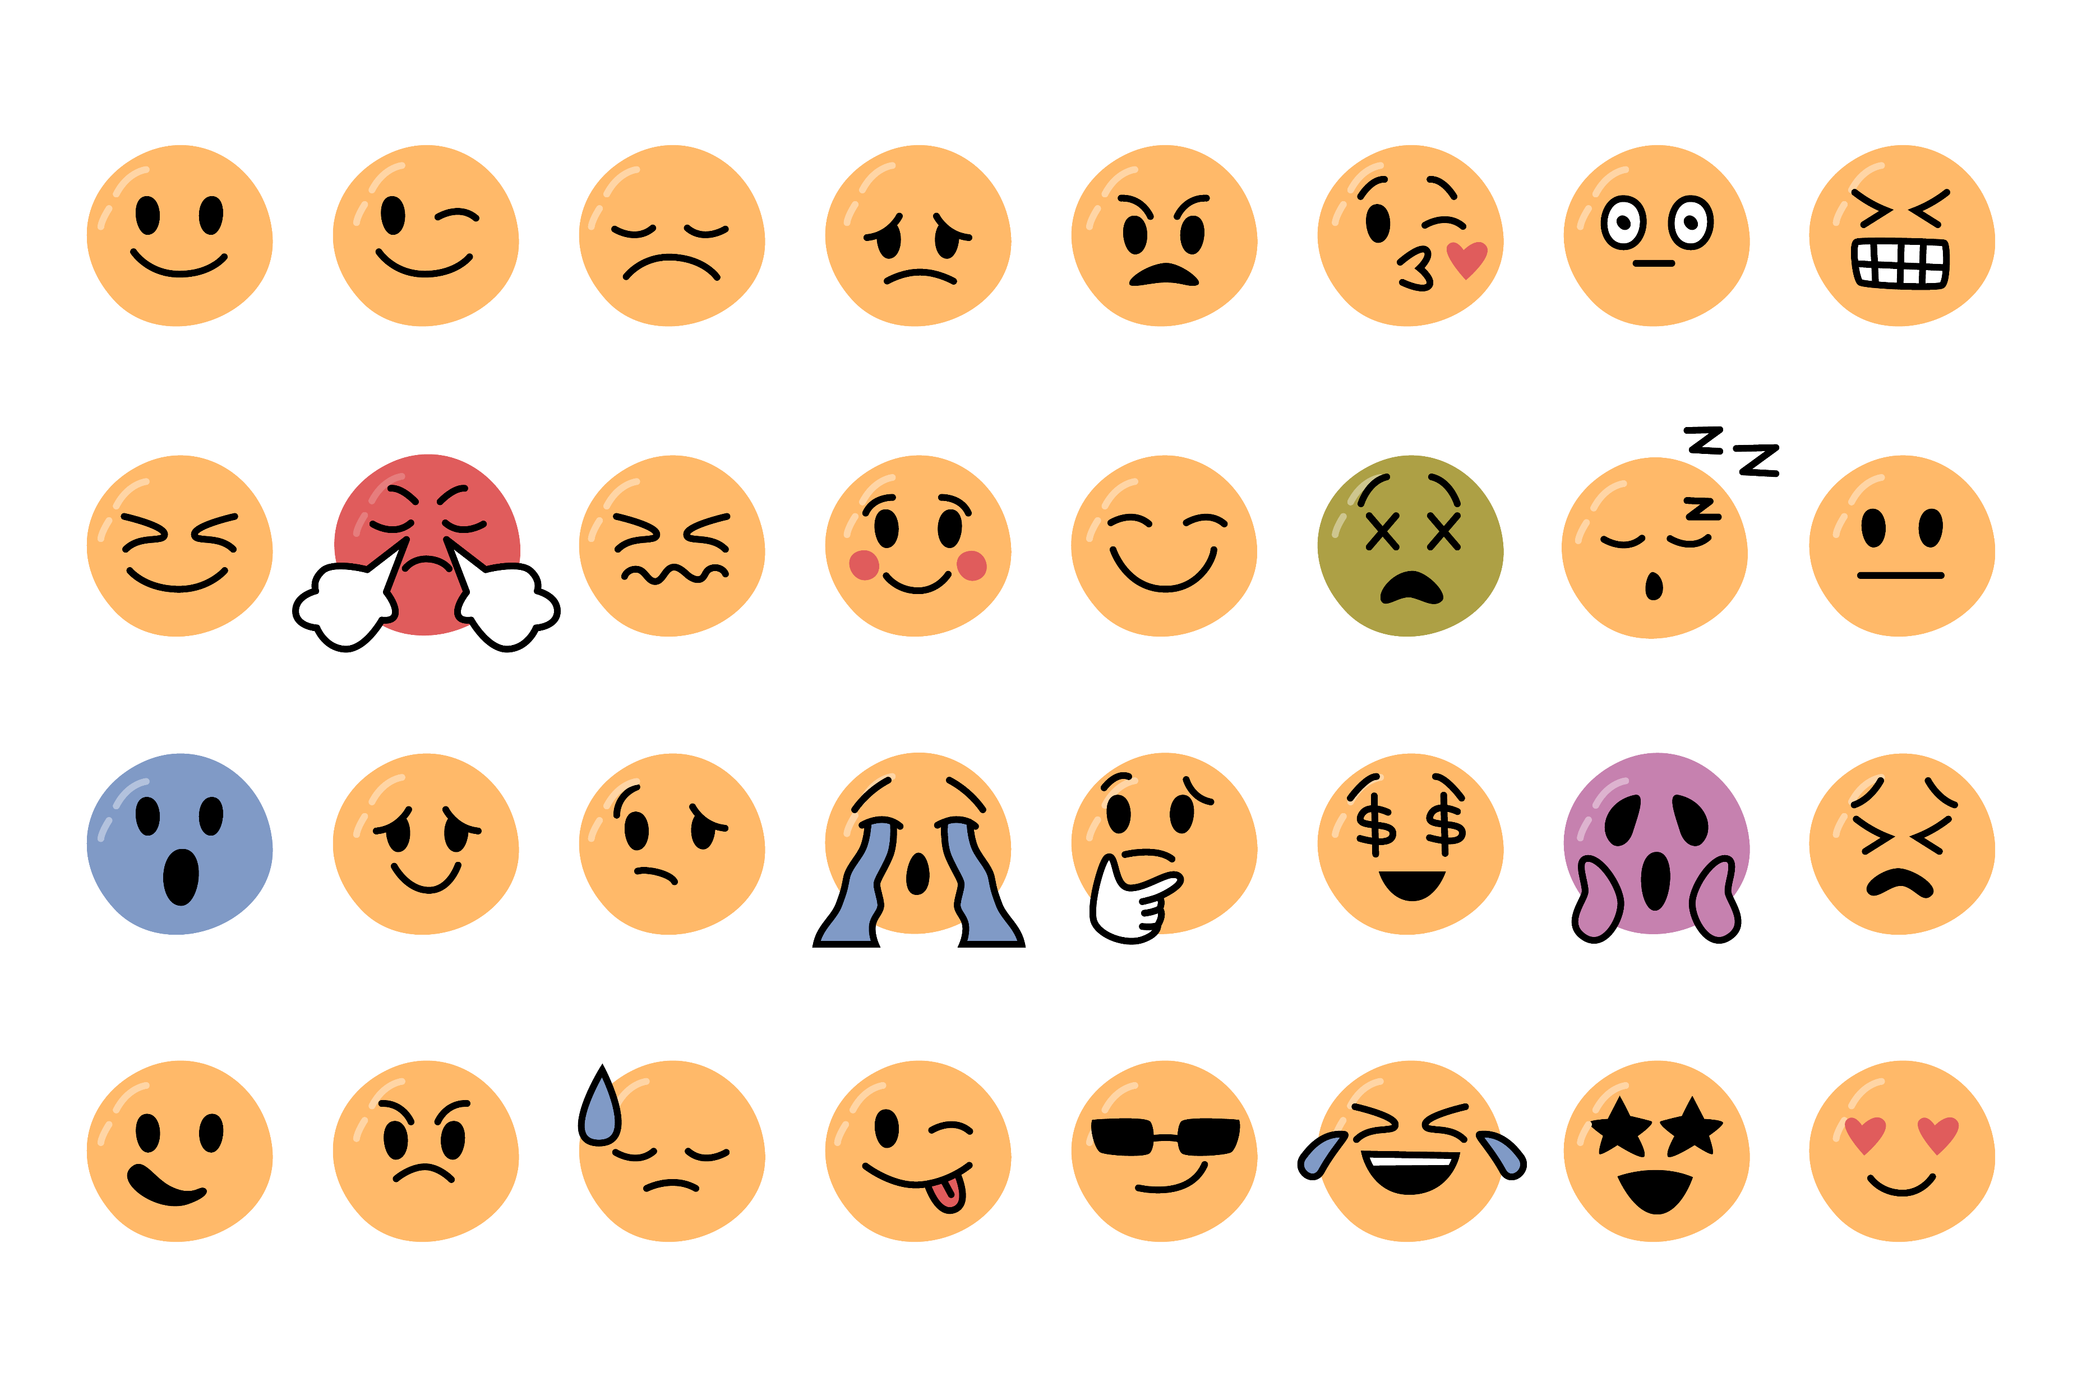
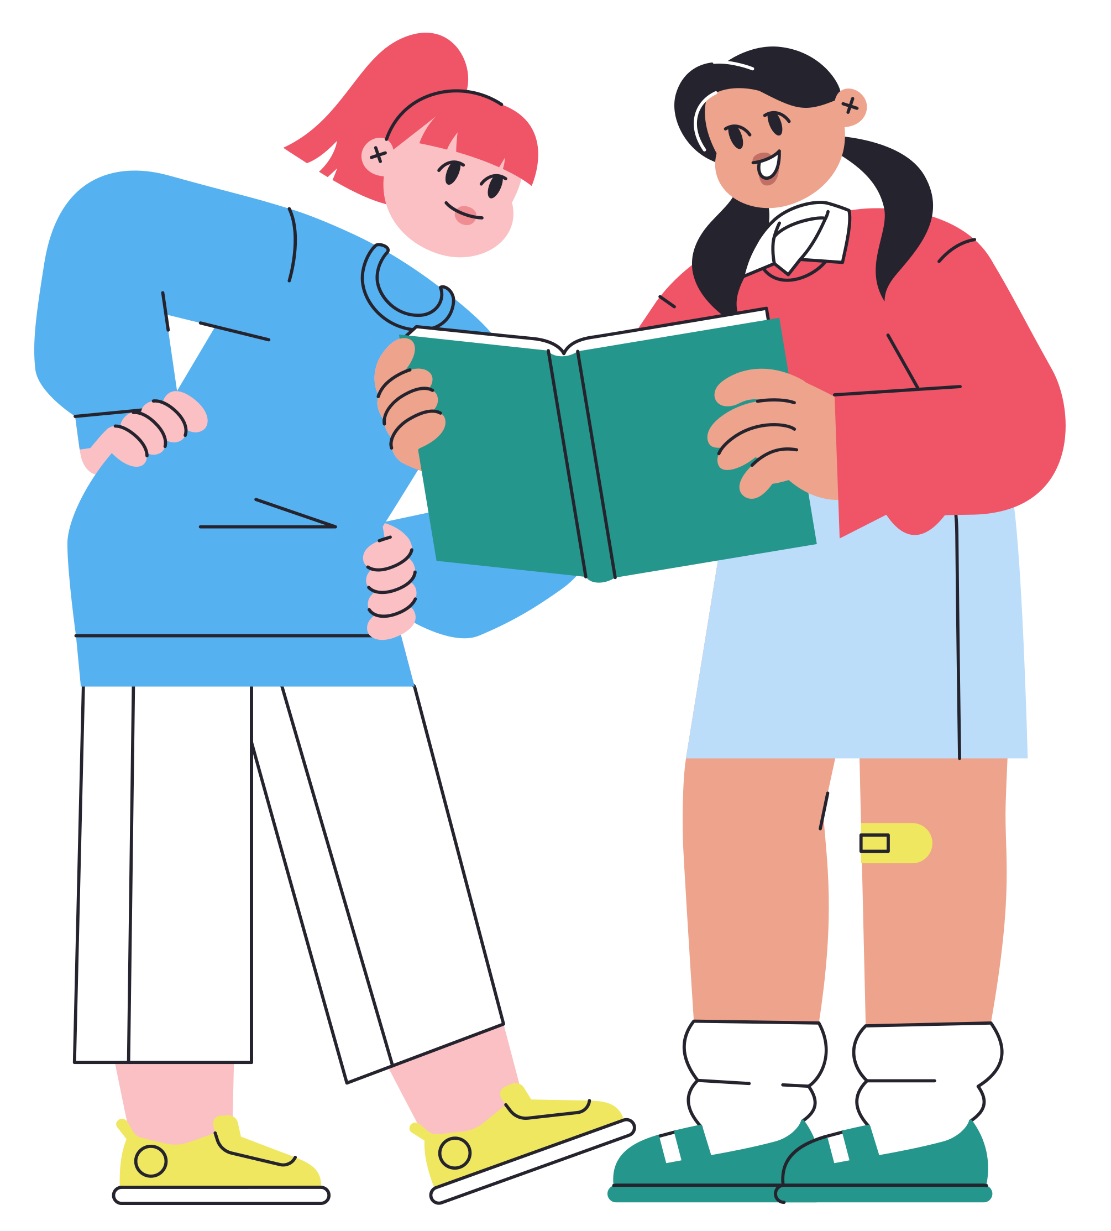
WHY DO OUR EMOTIONS MATTER?
And what do books have to do with it?
© Jigsaw Education Group
Notes:
Teacher notes:
Ask students how they are feeling today-pick our a few students to answer who are comfortable answering. Ask them if they know why they feel like that. If they don’t know, reassure them that it is okay because sometimes we don’t have the words. But today, we’re going to talk about how books can help give us those words
Image source: CuteSmilesSP.svg

Slide 3
WHY DO OUR EMOTIONS MATTER?
We all feel things deeply—joy, sadness, fear, excitement.
Learning to understand our emotions, can help us to understand ourselves.
Books, films, stories they can help us feel valued, heard, and less alone.
© Jigsaw Education Group
Notes:
Teacher notes:
Explain that books can help. Sometimes they show us characters who feel just like we do. And sometimes, they help us figure out what we're feeling by showing us someone else's story
Image source: CuteSmilesSP.svg

Slide 4
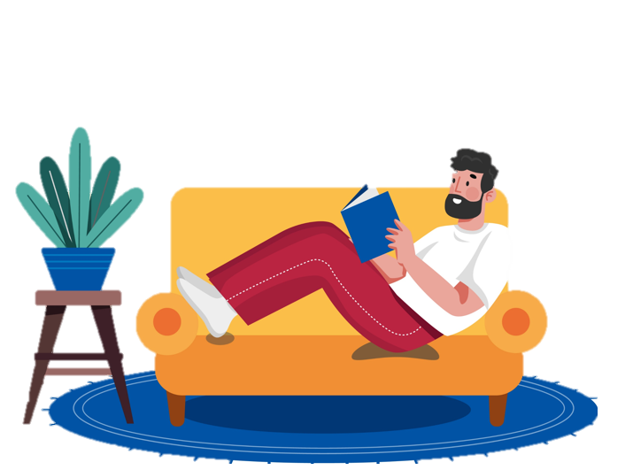
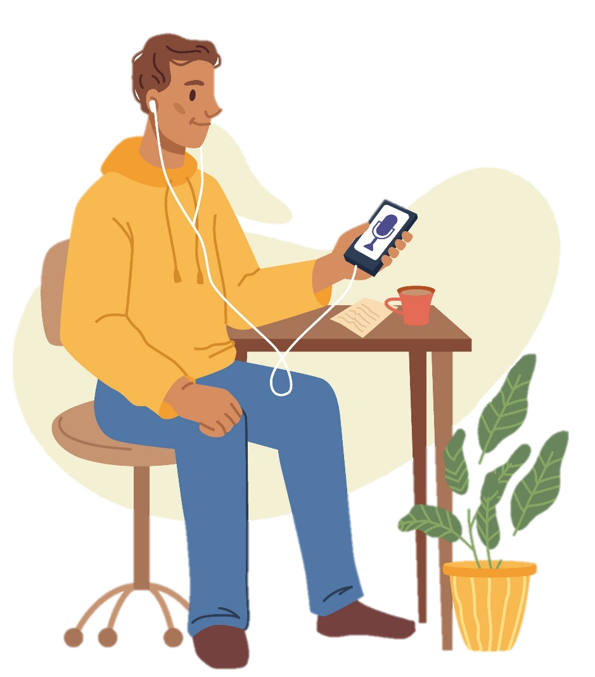
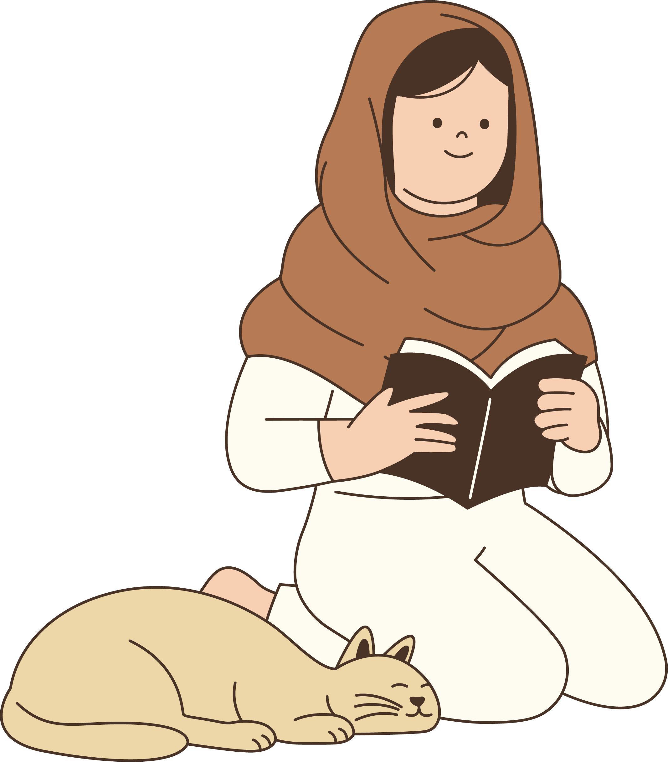
BOOKS AS SAFE SPACES
Reading can help us feel safe, valued,
and supported.
Books can help us discover new things, and help us to explore ways to overcome challenges.
When we see characters go through tough times, we can feel less alone.
Books can give us courage, comfort, and clarity.
© Jigsaw Education Group
Notes:
Teacher notes:
Explain that:
Books offer an escape from reality and a break from everyday stress.
They help us step out of our own heads and immerse in another world.
Relatable characters facing fear, grief, or exclusion can make us feel seen—and their resilience gives us hope.
Even without clear answers, books remind us we’re not alone in our struggles.
"Books" includes more than just novels—graphic novels, comics, and audiobooks can be just as impactful.
Image source:
Man Reading Book, Illustrations ft. book & book 3d – Envato
Podcasting set, broadcasting interviewing in mic, Objects ft. podcast & people – Envato
https://elements.envato.com/illustration-of-muslim-woman-reading-with-cat-2M8FLUY

Slide 5

BOOKS AS SAFE SPACES
Reading can help us feel safe, seen, and supported.
Think about your favourite story,
how does it make you feel?
© Jigsaw Education Group
Notes:
Teacher notes:
Ask students to think of their favourite story. It could be from a book, a graphic novel, even a story someone told you or that you listened to as an audiobook.
Ask students to think about how it made them feel when they first experienced it—or how it makes them feel now.
If you feel comfortable share your own answer to model it, then invite invite students to do the same.
Follow up with the question-What was it about the story that made you feel that way? Did it make you feel safe? Brave? Understood? Excited? Seen? Even sad—sometimes sadness in a story helps us process things.

Slide 6
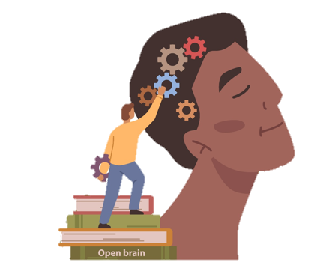
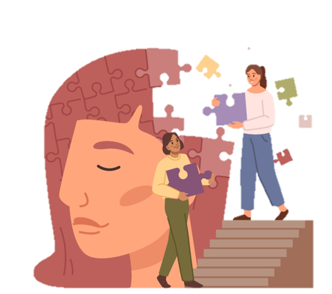
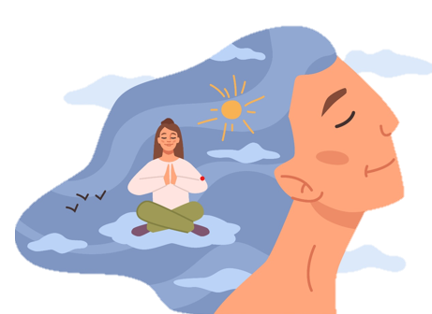
BOOKS THAT CAN SUPPORT EMOTIONAL WELLBEING
Books can help us explore emotions like anxiety, loneliness, self-worth, kindness, and courage.
They show us it’s okay to not be okay—and how we can keep going anyway.
Notes:
Teacher notes:
Explain that books don’t always solve our problems—but they remind us we’re not alone in them. And sometimes, that’s exactly what we need.
Explain that we are going to look at three amazing books that speak directly to our emotional lives. These are books that help us understand ourselves or others a little better.
Image source: Mental health and balance, mindfulness, Objects ft. mental health & mindfulness – Envato

Slide 7


Reading is powerful - it opens your mind, builds your vocabulary, and helps you understand the world from different perspectives.
Whether you're into fiction, biographies, or graphic novels, reading strengthens your critical thinking and fuels your creativity.
In a world full of distractions, picking up a book is a way to slow down and connect - with stories, ideas, and yourself.
Notes:
Teacher Notes:
Explain that every book students read helps to shape their thinking, imagination, and future.
Encourage students to find something that sparks their interest.

Slide 8
BOOKS THAT CAN SUPPORT EMOTIONAL WELLBEING
How many people here have read 'Wonder'?
(Penguin Random House)
© Jigsaw Education Group
Notes:
Teacher notes:
Pose the question and take responses.
Wonder by R. J. Palacio

Slide 9
BOOKS THAT CAN SUPPORT EMOTIONAL WELLBEING
Auggie is a boy who looks different from others and faces bullying and isolation.
Wonder is a powerful story, with the message ‘You are not alone, and kindness matters’
© Jigsaw Education Group
Notes:
Teacher notes:
Give the summary of the story and the message within it

Slide 10
BOOKS THAT CAN SUPPORT EMOTIONAL WELLBEING
How many of you have read 'The boy, the fox, the mole and the horse?' (Ebury Publishing)
© Jigsaw Education Group
Notes:
Teacher Notes:
Pose the question and take responses

Slide 11
BOOKS THAT CAN SUPPORT EMOTIONAL WELLBEING
A beautifully illustrated journey about friendship, courage, and acceptance.
This story reminds us that it is okay to ask for help.
© Jigsaw Education Group
Notes:
Teacher Notes:
Give the summary of the story and the message within it

Slide 12
BOOKS THAT CAN SUPPORT EMOTIONAL WELLBEING
Has anyone seen
'How To: Absurd Scientific Advice for Common Real-World Problems’ by Randall Munroe? (John Murray Press)
© Jigsaw Education Group
Notes:
Teacher Notes:
Pose the question and take responses

Slide 13
BOOKS THAT CAN SUPPORT EMOTIONAL WELLBEING
New ways to solve problems in totally over-the top ways that you will want to share with your friends.
This author shows us new ways to use science to have fun exploring ridiculous ideas that might just work!
© Jigsaw Education Group
Notes:
Teacher Notes:
This book looks at common problems and then uses science to overthink the problem and create ridiculous solutions that make you look at the problem in a new ay and sparks great conversations.
Sharing funny ideas helps us to connect with each other and look at life in new ways – even if they are not practical at all for the problem in hand!

Slide 14
BOOKS THAT CAN SUPPORT EMOTIONAL WELLBEING
Who here gets stressed sometimes?
© Jigsaw Education Group
Notes:
Teacher Notes:
Pose the question and take responses-be mindful of student responses and answers being appropriate. You may give examples of what might cause stress that are safe and non-specific, such as, homework, exams, your team losing a match, losing your belongings. Remind students that it is okay to feel stressed, everyone experiences stress at times.

Slide 15
BOOKS THAT CAN SUPPORT EMOTIONAL WELLBEING
'Stress Less: Mindfulness for Teenagers' by Adam Avin is a book written by a teen, for teens—so it actually gets what you're going through.
It shares easy mindfulness tips to help you handle stress, feel more in control, and stay calm when life gets overwhelming. (Trigger Publishing)
© Jigsaw Education Group
Notes:
Teacher notes:
Give the summary of the story and the message within it.

Slide 16
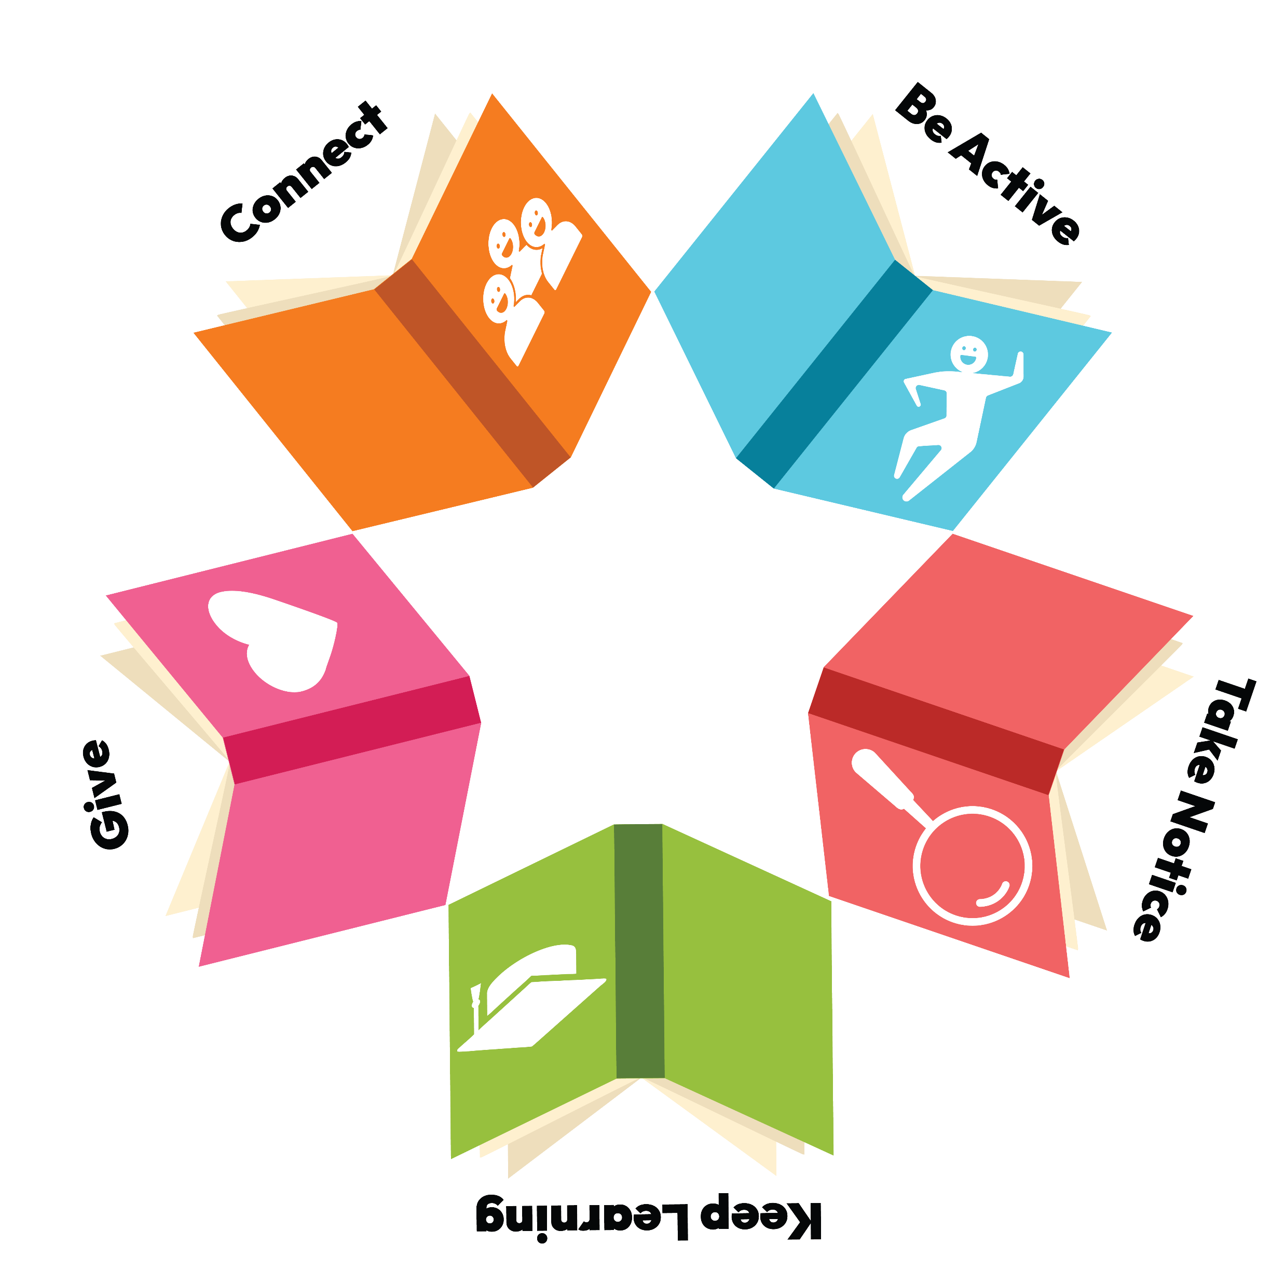
READING IS POWERFUL,
IT CAN HELP US TO...
Connect: building relationships and empathy
Be Active: inspiring movement and well-being
Take notice: encouraging mindfulness and emotional awareness
Keep learning: through curiosity, imagination and a love of learning.
Give: highlighting kindness, sharing and making a difference.
Notes:
Teacher Notes:
Explain the 5 steps to wellbeing.

Slide 17

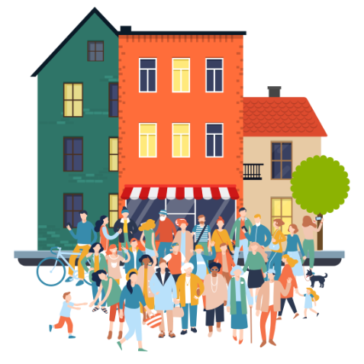
BELONGING AND COMMUNITY
Have you got an unusual hobby? Reading about it can help you find others like you.
Have you ever read a book that helped you feel connected—to someone in the book, or
someone in real life?
© Jigsaw Education Group
Notes:
Teacher notes:
Explain that books can help us to feel part of something bigger. Whether it’s connecting with characters, classmates, or authors—we realise we’re not alone in how we feel.
Explain that stories can also help us to feel connected to others. Whether you’re reading a book on your own or in a classroom, you’re stepping into a story that many people have stepped into before.
Maybe you’ve read something and thought: ‘Wow, someone else feels like me.’ That creates a sense of community—even if it’s just between you and a character, or between classmates who all cried or laughed at the same part.
Books can build belonging in different ways:
– You might feel seen by a character who shares your culture or experience. You are never alone when you’re in a story
– You might discover people different from you—and learn to understand them better.
– You might share a book with a friend and talk about it for weeks.

Slide 18
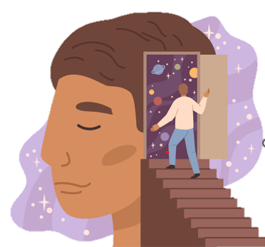
MINDFUL MOMENTS
Take 30 seconds to pause.
Think of a story where someone faced something difficult...
What helped them through it?
How did they grow?
© Jigsaw Education Group
Notes:
Teacher notes:
Ask students to take 30 seconds to reflect.
Those who are comfortable doing so may close their eyes.
Ask students to think of a story or film where someone went through something hard and challenging but came through it in the end. What helped them? How did they grow and overcome it?
(Let there be silence for about 30 seconds—don’t rush it.)
Tell students that they don’t have to share what they thought of—but just to notice how that story made you feel. These are the quiet moments where stories stay with us. When a character grows, we grow with them—even if it’s just a little.
Image source: Mental health and balance, mindfulness, Objects ft. mental health & mindfulness – Envato

Slide 19

CHALLENGE YOURSELF
Talk to someone about a story that made you feel something.
Or ask a friend: “What’s the last story that you read that has really stayed with you?”
© Jigsaw Education Group
Notes:
Teacher Notes:
Challenge students to take one moment today to talk about a story that made them feel something.
Or, they can ask a friend what was the last book they read that had an impact on them?
Remind students that World Book Day isn’t just about costumes or characters—it’s about finding space to relax, to reflect, and to remember that stories help us understand others and ourselves.
Image source: https://elements.envato.com/bookshelves-with-paper-books-set-95XN4NH

