Slide 1

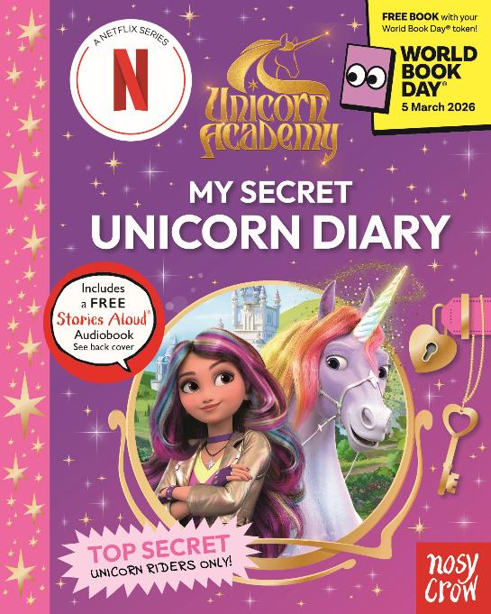


Unicorn Academy & World Book Day® 2026
Q&A
Sponsored by
The reading for fun charity
World Book Day® is a registered charity, company, and trademark

Slide 2
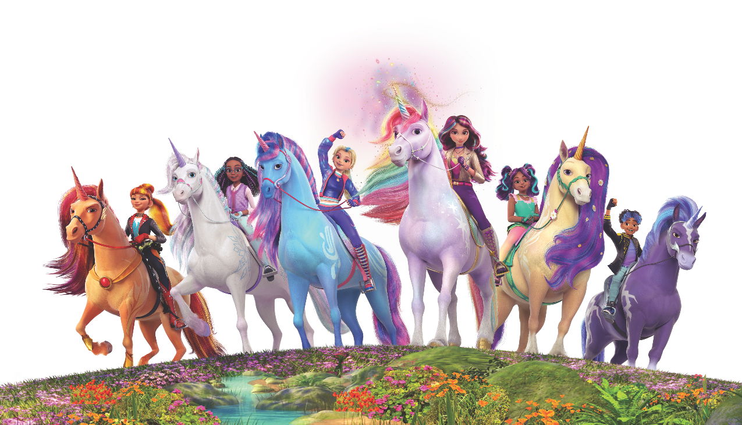

Meet the Sapphires
Sophia, Ava, Layla, Isabel, Rory and Valentina are the Unicorn Riders of Sapphire dorm at Unicorn Academy.
© 2026 Spin Master Ltd. UNICORN ACADEMY and all related titles, logos and characters, and SPIN MASTER logo are trademarks of Spin Master Ltd., used under license. All rights reserved.

Slide 3
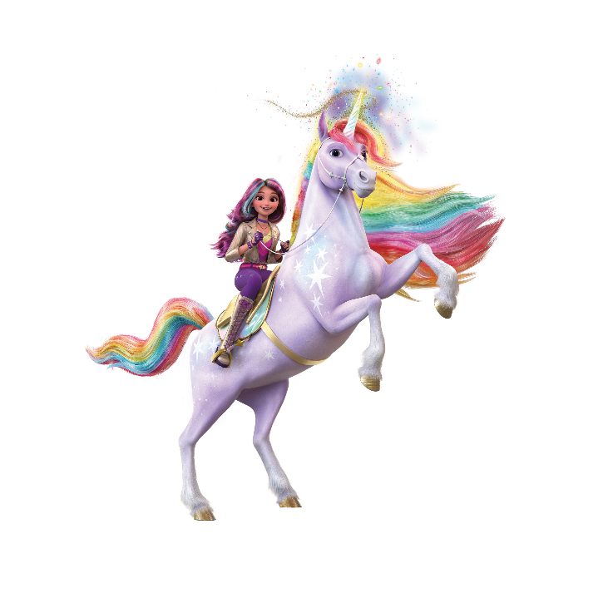
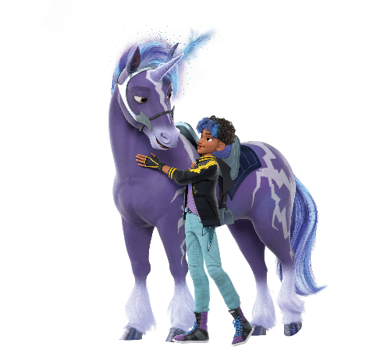
What are Unicorn Academy books about?
Unicorn Academy is the school of every child’s dreams, and the books are all about magic, friendship and, of course, unicorns! Sophia and the rest of her class must bond with their unicorns to unlock their magical powers. Only then will they learn how to become legendary Unicorn Riders and help protect the island, its magic and its unicorns.
© 2026 Spin Master Ltd. UNICORN ACADEMY and all related titles, logos and characters, and SPIN MASTER logo are trademarks of Spin Master Ltd., used under license. All rights reserved.

Slide 4
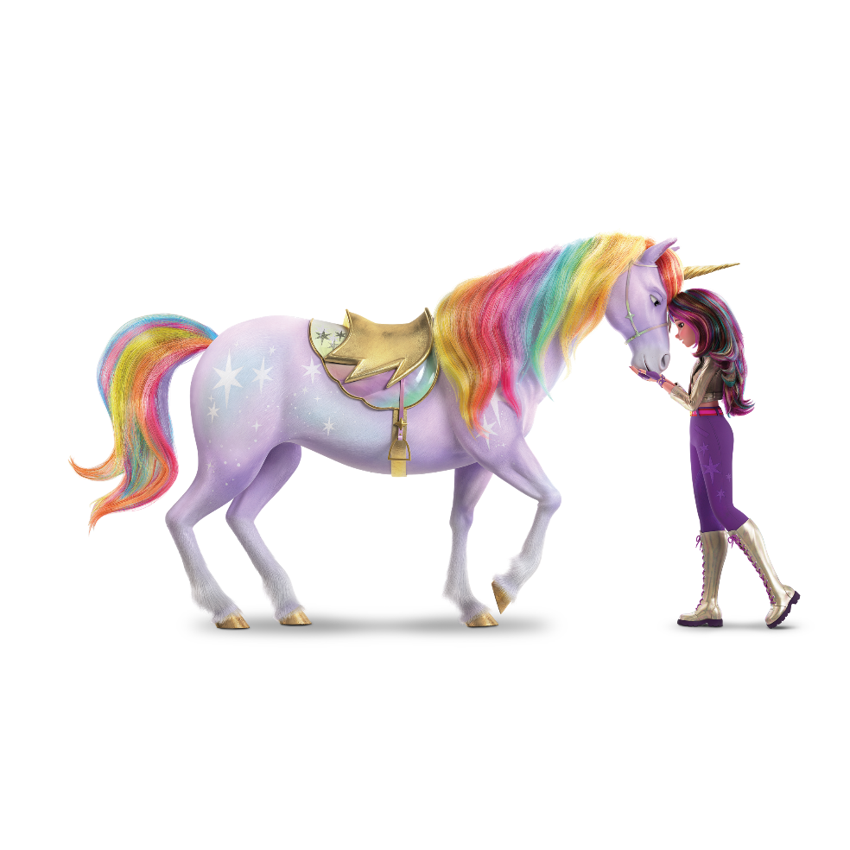
What mood or situation would you recommend your books for?
Unicorn Academy books are perfect for jumping into a fantastic, magical world at any time of day! Each exciting story is packed with epic adventures and ultimately it is the strong bonds between the riders and their unicorns that save the day.
You can enjoy these books while relaxing at home or sharing together with friends.
© 2026 Spin Master Ltd. UNICORN ACADEMY and all related titles, logos and characters, and SPIN MASTER logo are trademarks of Spin Master Ltd., used under license. All rights reserved.

Slide 5

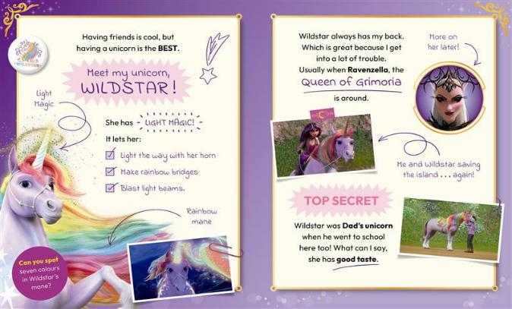
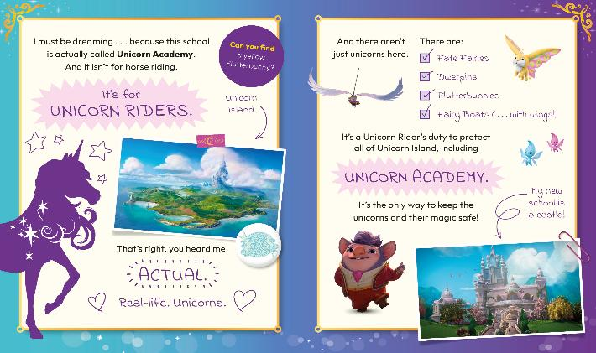
Tell us about your World Book Day £1/€1.50 book
Discover what Sophia really thinks of her first year at Unicorn Academy in this super-secret diary! Peek inside Sophia’s magical world, filled with sparkling unicorns, epic adventures and legendary secrets. The perfect book for fans of the TV show!
© 2026 Spin Master Ltd. UNICORN ACADEMY and all related titles, logos and characters, and SPIN MASTER logo are trademarks of Spin Master Ltd., used under license. All rights reserved.

Slide 6


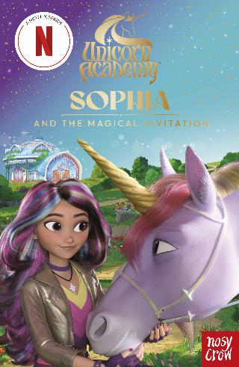
Can you suggest three books that would be good to read next?
An explosive graphic novel fizzing with fun and invention.
Read the original story that inspired the Netflix show.
Follow Sophia’s very first adventure at Unicorn Academy.
© 2026 Spin Master Ltd. UNICORN ACADEMY and all related titles, logos and characters, and SPIN MASTER logo are trademarks of Spin Master Ltd., used under license. All rights reserved.

Slide 7
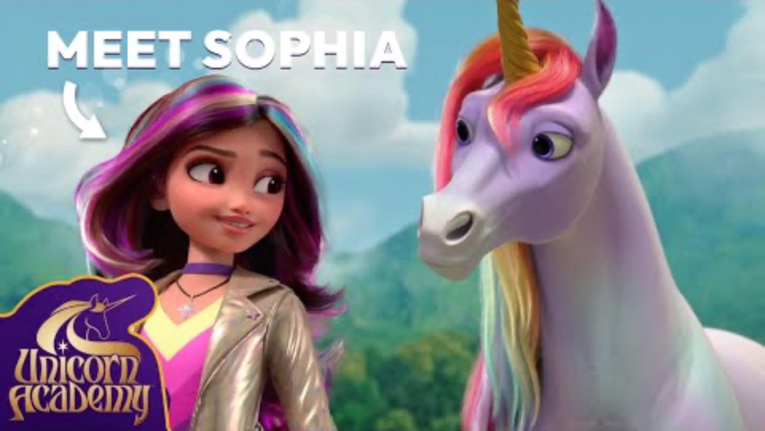
Ride towards your destiny!
© 2026 Spin Master Ltd. UNICORN ACADEMY and all related titles, logos and characters, and SPIN MASTER logo are trademarks of Spin Master Ltd., used under license. All rights reserved.

Slide 8
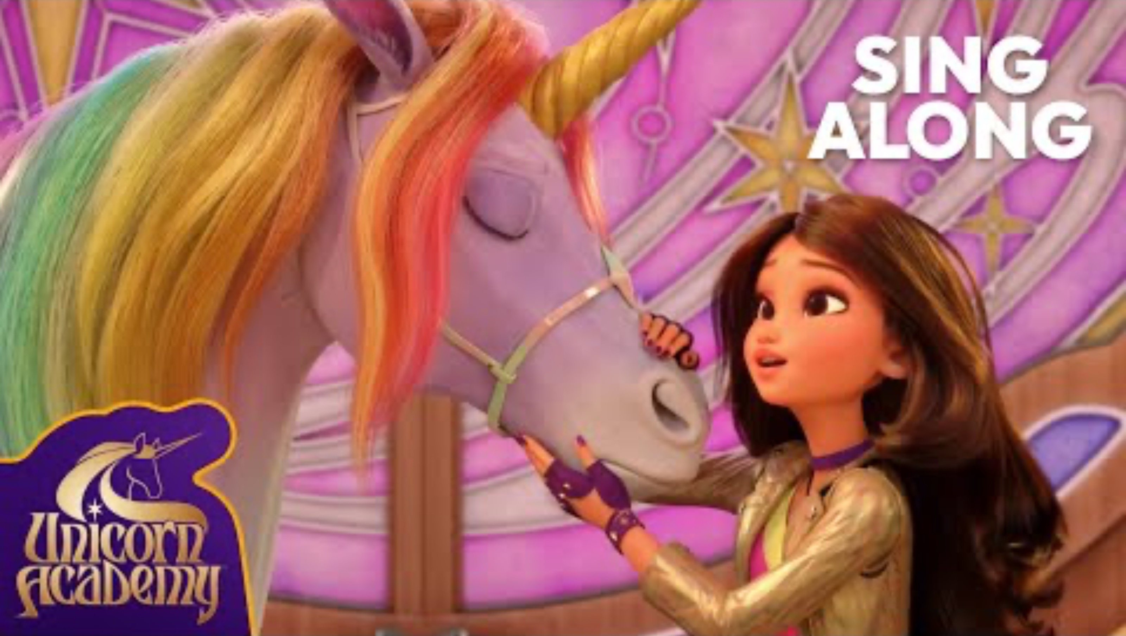
Sing your heart out!
© 2026 Spin Master Ltd. UNICORN ACADEMY and all related titles, logos and characters, and SPIN MASTER logo are trademarks of Spin Master Ltd., used under license. All rights reserved.

Slide 9
Happy World Book Day®

