Slide 1


Education staff briefing 2026

Slide 2
Contents
Check the notes section of each slide for scripts, references and further links.
Welcome to your 2026 briefing
Section 1 World Book Day the charity
Our mission
It’s all about reading for fun
As a result of World Book Day children…
Section 2: Go all in for World Book Day in the National Year of Reading
Children’s reading for pleasure seems to be in crisis
But telling children about the benefits isn’t motivating them
How to use World Book Day
Go All In For World Book Day
Section 3: World Book Day timeline
Key dates and what to expect
2026 campaign timeline – key dates
World Book Day events
Section 4: World Book Day Conversations: from Celebration to a Reading for Pleasure Strategy
Research background
Key Takeaways (this slide needs de-jargoning)
Looking for More?
Section 5: Resource spotlights
WBD Website update
Planning Tool
Assemblies
Jigsaw Education Wellbeing Book Swap
Pupil Voice- Dressing up
Breakfast and a Book: An opportunity to connect with your school community

Slide 3





Welcome to your 2026 Briefing
Today's agenda
World Book Day as part of the National Year of Reading
Planning a World Book Day event with impact
Timeline
New website and resource spotlights

Slide 4
Section 1: World Book Day the charity

Slide 5


Our mission
To champion
the fun of
reading*
*because it seriously improves children’s lives
Notes:
We also have a brand-new look for 2026. Bold, bright and playful, we champion the fun of reading in everything we do. By showing children the connections they can make with their lives in reading rather than telling them why it’s good for them we hope to achieve the benefits using fun as an unlocker. You will automatically receive branding links to the addresses registered for tokens and World Book Day newsletter signups.
Children are more likely to read if they enjoy it, so we’re on a mission to encourage them to see reading as an entertaining, social and fun thing to do.
We want more children to grow up with a life-long, life-changing habit of reading for fun, and all the benefits this brings.

Slide 6




It’s all about reading for fun
We know that when children choose to read more it makes them:
Better at reading
Feel happier
More successful
Our Big Six principles that encourage children to read for fun:
Being read to regularly
Having books at home and school
Finding time to read
Having a choice in what to read
Having trusted help to find a book
Seeing reading as fun!

Slide 7
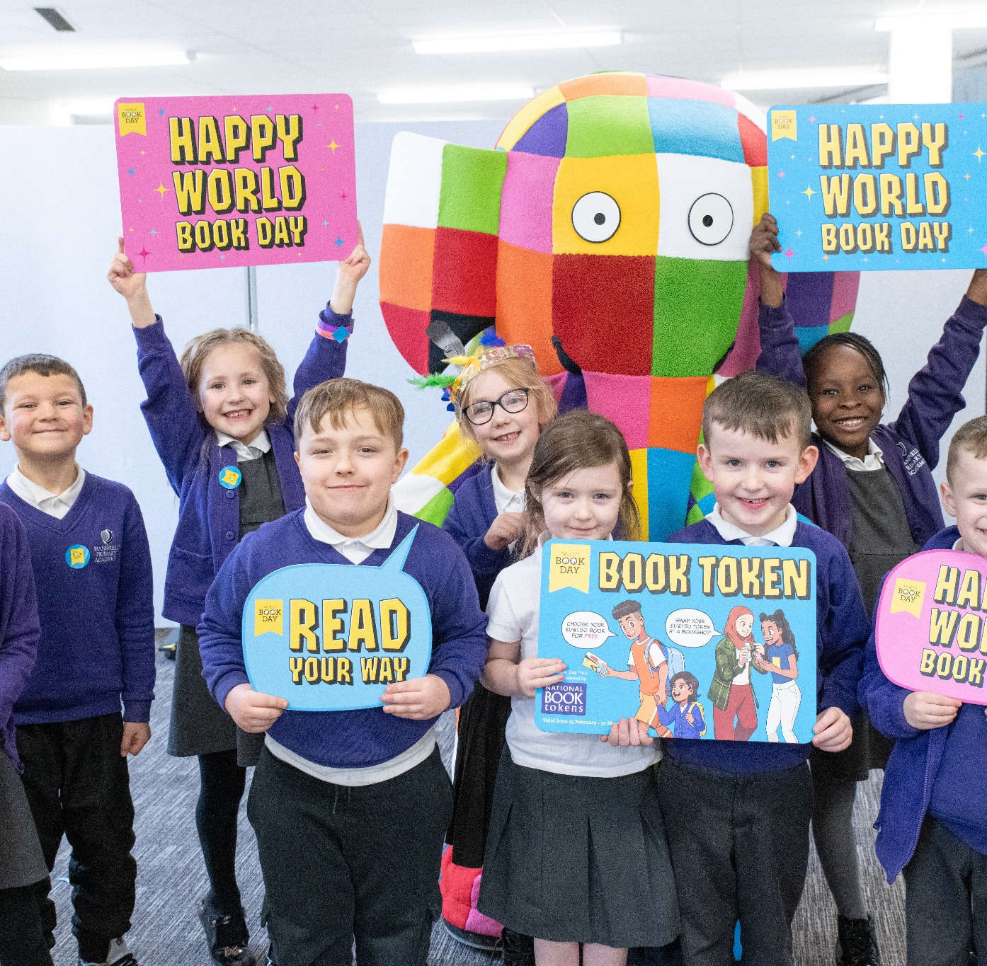

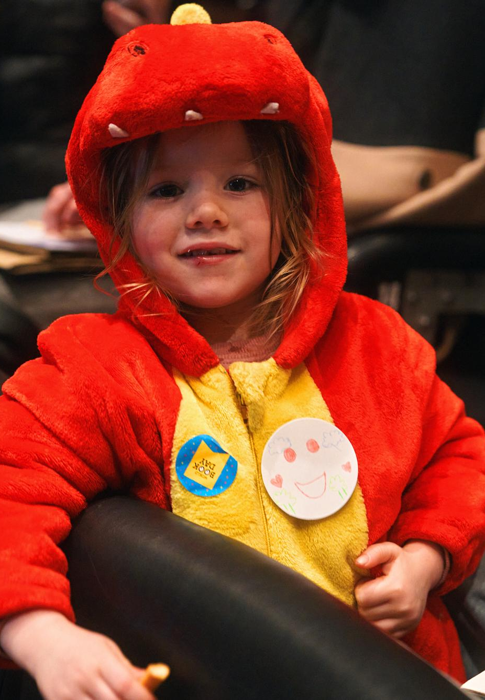
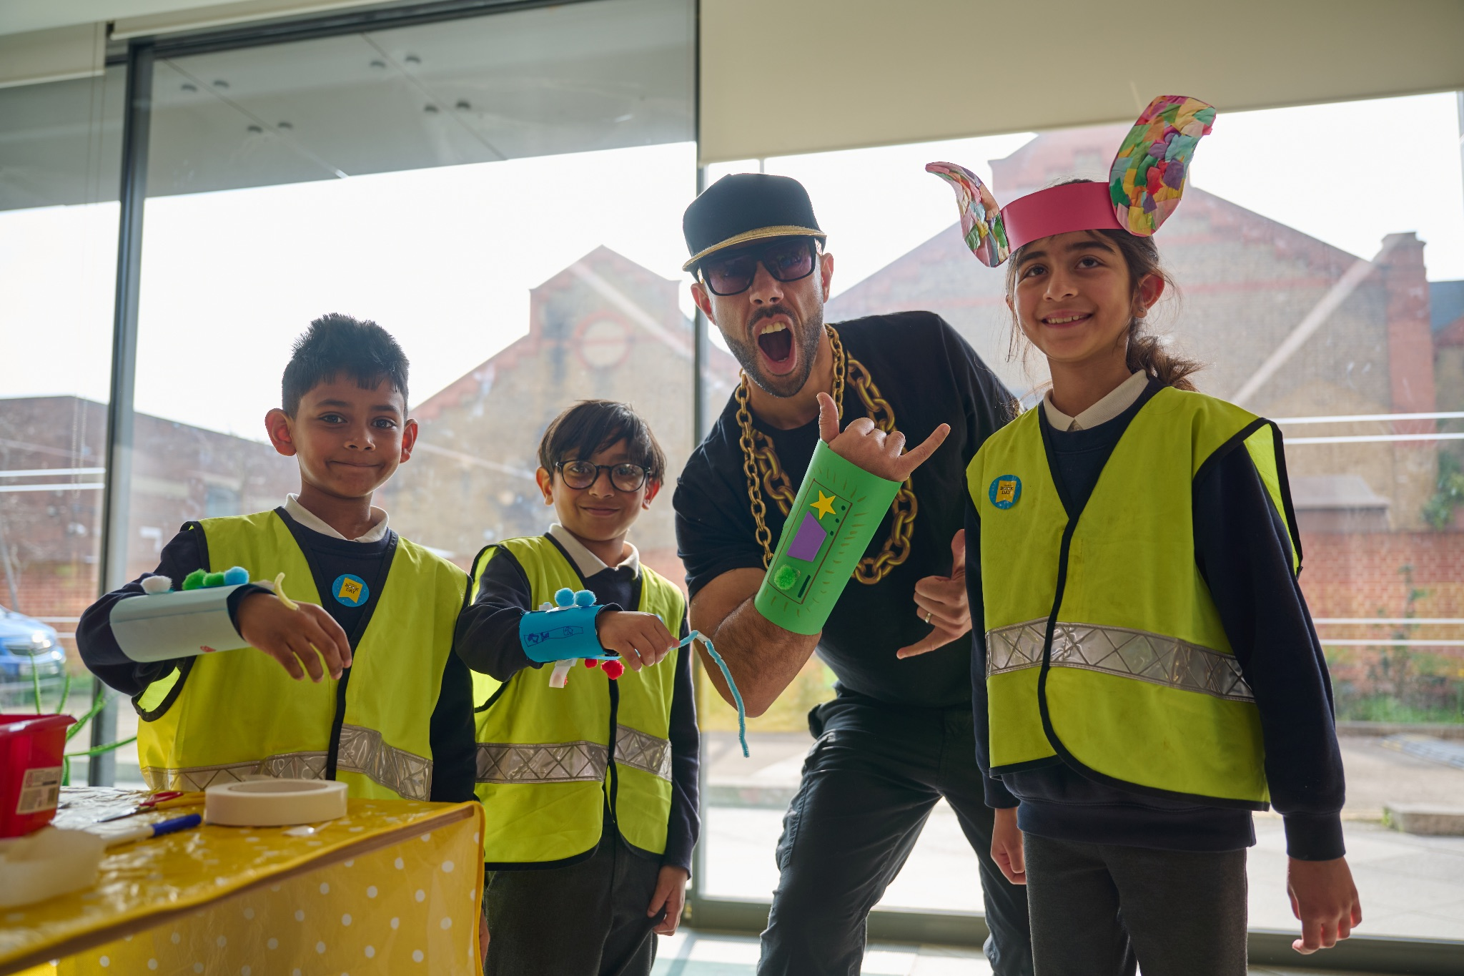
As a result of World Book Day children…
Find reading more fun 38.6%
Made more time to read 35.3%
Have more choice in what to read 36.7%
Talk more with family / friends 30%
Read with parent / carer 24.3%
Find new books to read 37.0%
1 in 4 (FSM) say the £1 book is the first book of their own.
Notes:
These results come from the National Literacy Trust’s Annual Literacy Survey, the same one that shows the decline in reading for pleasure. https://literacytrust.org.uk/research-services/research-reports/children-and-young-peoples-reading-in-2025/

Slide 8
Section 2: Go all in for World Book Day in the National Year of Reading
Notes:
World Book Day is one of the first big diary dates within the National Year of Reading. Discover what World Book Day and National Year of Reading have found about children’s reading. Understand how your World Book Day celebrations can be bigger and better as part of the National Year of Reading

Slide 9


Children’s reading for pleasure seems to be in crisis
Reading for pleasure matters
The benefits are clear
BUT…
It’s the single biggest indicator that a child will grow up to enjoy a happier and more successful life – more than their family circumstances, their parents’ educational backgrounds or their income.
Source: OECD 2002 and 2019
Wellbeing and self-esteem
Brain and cognitive development
Learning across the curriculum
Empathy, imagination
and creativity
Source: Various
only 1 in 3 children enjoy reading
Reading for pleasure is at its lowest level since 2005.
Source: National Literacy Trust 2025
Notes:
The research findings and stats are here: https://www.worldbookday.com/about-us/our-approach/

Slide 10
Telling children about the benefits isn’t motivating them

Slide 11
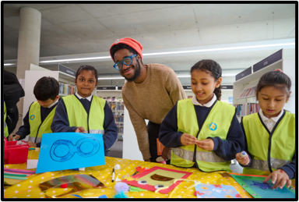

How to use World Book Day
Our messaging focuses on changing attitudes and behaviours, based on what children say would encourage them to read.​
let go of pressure and expectations
give children a choice – and a chance –
to enjoy reading.
Celebrate choice:
reading in all forms is valid (audio, comics, books…)
Relevance and reflection:
hobbies and passions, reading and…
Reading for fun and family life:
reading to children.
FUN
is the
unlocker!
Notes:
Children say they’re told reading is great, but we’re showing them that reading is something that they have to do, rather than choose to do.
Evidence from: OU Reading for Pleasure Project, Beano Brain commission, National Year of Reading research
For more information on reading research that inform World Book Day’s work visit https://www.worldbookday.com/about-us/our-approach/

Slide 12

Go All In For World Book Day
World Book Day will be bigger and better than ever during the National Year of Reading 2026
The National Year of Reading is a nationwide campaign to get more people reading, by bringing reading to where culture is.
Reading is a powerful plug-in to the things you already love – a great way to go deeper into your existing passions. Put simply: ‘If you’re into it, read into it.’

Slide 13
Section 3: World Book Day timeline
Key dates and what to expect

Slide 14
2026 campaign timeline – key dates
Dates | Activity
8 December | All resources available on World Book Day website World Book Day and partners online schools event booking opens
January | School and nursery packs delivered by post: £1/€1.50 tokens, posters and key information
12 February | £1/€1.50 book token redemption period starts Token exchange open – give out your book tokens early to offer your students the best selection Bookshops welcome children in with their tokens to choose their £1/€1.50 books for free.
5 March | World Book Day
15 March | Book token redemption ends

Slide 15
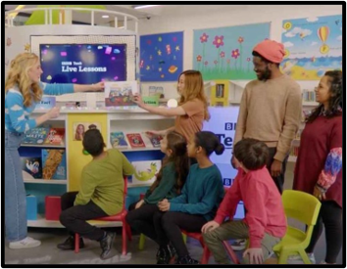
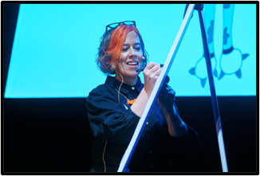
World Book Day online events
For 5-11 year olds
World Book Day BBC Live Lesson
Pobble
National Literacy Trust's Great Footy and Booky Quiz
For 11+ year olds
Waterstones Digital Event with Nathanael Lessore
Harry Potter and the Cursed Child
Notes:
Find out more about all these and family facing content on https://www.worldbookday.com/events/

Slide 16


Section 4: World Book Day Conversations: from Celebration to a Reading for Pleasure Strategy

Slide 17
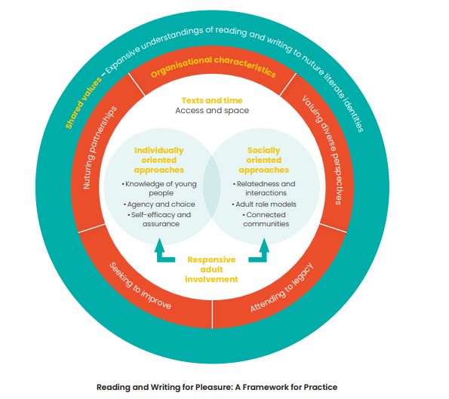
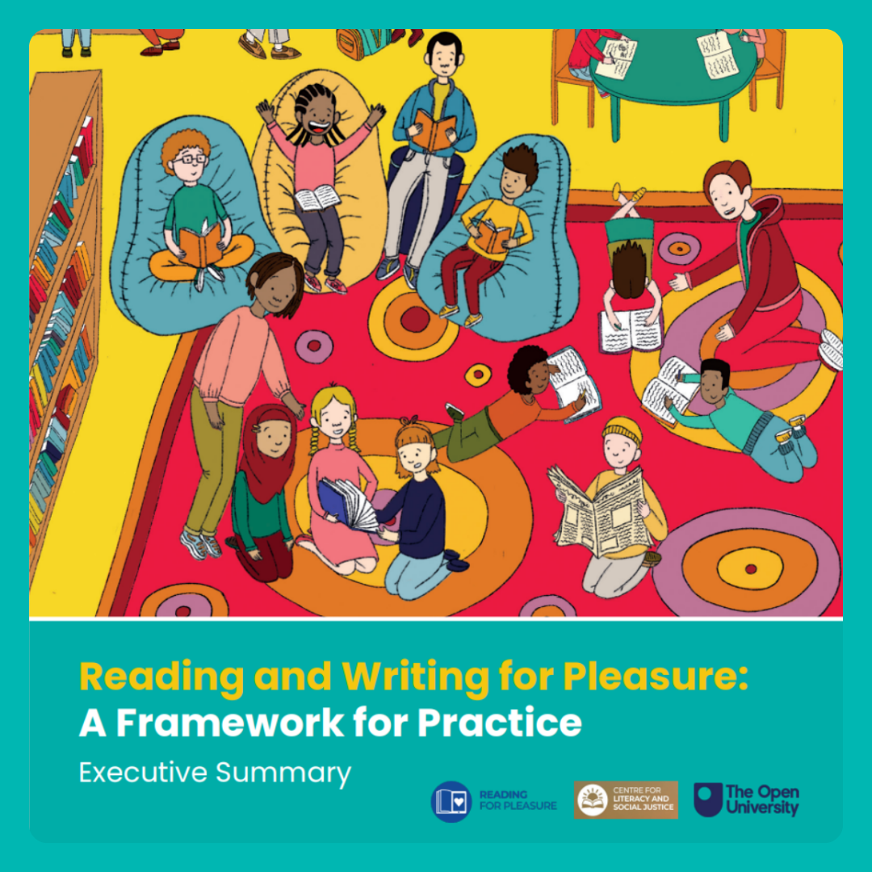
Research background
Notes:
Through a study of reading and writing interventions by charities (including World Book Day) combined with a literature review of effective practice Teresa Cremin and her team at The Open University have created a model that as we begin planning for World Book Day and consider how we will deliver a National Year of Reading might be useful. The diagram on the screen offers a setting wide framework for discussing the type of environment we might want to create if we are considering a pupil focussed reading for pleasure environment. This isn’t a checklist as much as a what this model can offer is an opportunity to consider your whole setting and areas you might want to develop across the year. Reading and Writing A Framework for Practice can be downloaded here: https://cdn.ourfp.org/wp-content/uploads/20231201185032/Reading-and-Writing-for-Pleasure_FRAMEWORK-DIGITAL-FINAL-30.11.23.pdf?_gl=1*1pqbzvl*_ga*MTI4OTE2NjY1OC4xNzY0MDc4ODk3*_ga_56HENEGN4V*czE3NjQwOTAwNTUkbzIkZzAkdDE3NjQwOTAwNTUkajYwJGwwJGgw

Slide 18
The Podcasts
Planning World Book Day – where do you start? Will you dress up? What do you want the impact to be?
Engaging your school and wider community – including all staff, involving parents, author visits and community organisations
Delivery – practitioners discuss the implementation of ideas and how they went.
Notes:
This work builds on last year’s Overcoming Barriers to Reading for Pleasure series –still available which World Book Day and The Open University Delivered in partnership.
These conversations with practitioners share both strategic and tactical ways to engage with World Book Day and support delivery of a day that fits into a wider Reading for Pleasure framework
Planning World Book Day – where do you start? Will you dress up? What do you want the impact to be?
Engaging your school and wider community – including all staff, involving parents, author visits and community organisations
Delivery – practitioners discuss the implementation of ideas and how they went.

Slide 19
Key Takeaways
Reflect on last year’s celebration and what was successful or less so
Listen to your pupils, parents and staff are before you start to plan
Have an aim and rationale for the day
Plan for impact: Identify an area you want to target and can feasibly follow up after the day
Purposeful fun – children experience a fun day but you have a tangible outcome too (even better if the children don’t notice!)
Engaging parents – Create informal opportunities for parents to be engaged with the fun alongside their children.
Give staff the opportunity to get to know their readers and their families
Doing the things you’ve always done can be reassuring but they always worth reviewing in light of your aims
Include activities that you can come back to later in the year or incorporate into ongoing practice.
Think about who else across your school and local community can contribute or be part of ongoing provision.
Notes:
This work builds on last year’s Overcoming Barriers to Reading for Pleasure series –still available which World Book Day and The Open University Delivered in partnership.
These conversations with practitioners share both strategic and tactical ways to engage with World Book Day and support delivery of a day that fits into a wider Reading for Pleasure framework
Planning World Book Day – where do you start? Will you dress up? What do you want the impact to be?
Engaging your school and wider community – including all staff, involving parents, author visits and community organisations
Delivery – practitioners discuss the implementation of ideas and how they went.

Slide 20





Looking for More?
Overcoming Barriers to Reading for Pleasure
The Open University's Reading for Pleasure Research and Practice website
World Book Day Resources
Your local English Hub
With thanks to:
Notes:
This work builds on last year’s Overcoming Barriers to Reading for Pleasure series –still available which World Book Day and The Open University Delivered in partnership.
If you want more ways to engage with this kind of content our original series of conversations in Overcoming Barriers to Reading for Pleasure https://www.worldbookday.com/about-us/our-approach/overcoming-barriers-to-reading-for-pleasure/ is a good place to start.
For practical help and resources try:
https://ourfp.org/
Worldbookday.com/resources
http://www.englishhubs.org/
This year the National Year of Reading website will also host a number of resources and signposts to other organisations. Literacy Hive is also a good signposting service for local and national programmes https://literacyhive.org/

Slide 21
Section 5: Resource spotlights

Slide 22

WBD Website update
Notes:
You’ll notice there’s no PDF download this year – we’ve captured the key information on our Educators page and worked on making the best of our Reading for Pleasure resources accessible on our resources page with the option to search by age, type, reading principle. We hope this will save you time trying to hunt through packs for ideas from previous years. The search function is also improved and should help you find what you need.

Slide 23

Planning Tool
Notes:
This tool is designed to support your planning and wider communications

Slide 24

Planning World Book Day
What are we trying to achieve with our World Book Day Celebrations?
Your answer here
What are the messages we want to share with caregivers?*
Think about:
What’s the message?
How and when will it be communicated?
Whose job is it?
Is it booked in?
What are our students’ key barriers to Reading for Pleasure? How do we know?
Your answer here
*The World Book Day Family and Caregiver Communications Toolkit might be useful to refer to here

Slide 25
Planning World Book Day
Purpose and rationale | Activity | Resources needed | What’s the timeline for this activity? (Before, during, after) | Share with caregivers? | Success markers | Reflection
To ensure all children are clear about the purpose of the day | World Book Day Assembly | Assembly powerpoint |  | Yes - invited to join the assembly | Teacher feedback on likes/dislikes/questions following the assembly
To explore and share home reading identities | Home language reading river | Paper and pens |  | Yes – set as homework over half term and invited to come into school for when they are shared. | Children and caregivers: more confident to talk about home reading Staff: feel more confident talking to children about what they are reading at home and making recommendations

Slide 26



Assemblies
Notes:
Shapes for Schools and World Book Day have created a Primary and Secondary assembly inviting children to think about where reading might fit in their home lives.
Our assemblies are designed to give you a structure, this year they are speaking to World Book Day being part of a National Year of reading and specifically how reading can feel part of children’s home lives. They have YouTube video clips that can be chosen from our authors. All the assemblies are editable so you can tailor them to the needs of your school community.
5-11 https://www.worldbookday.com/resources/world-book-day-5-11-assembly/
11+ https://www.worldbookday.com/resources/world-book-day-11-assembly/

Slide 27

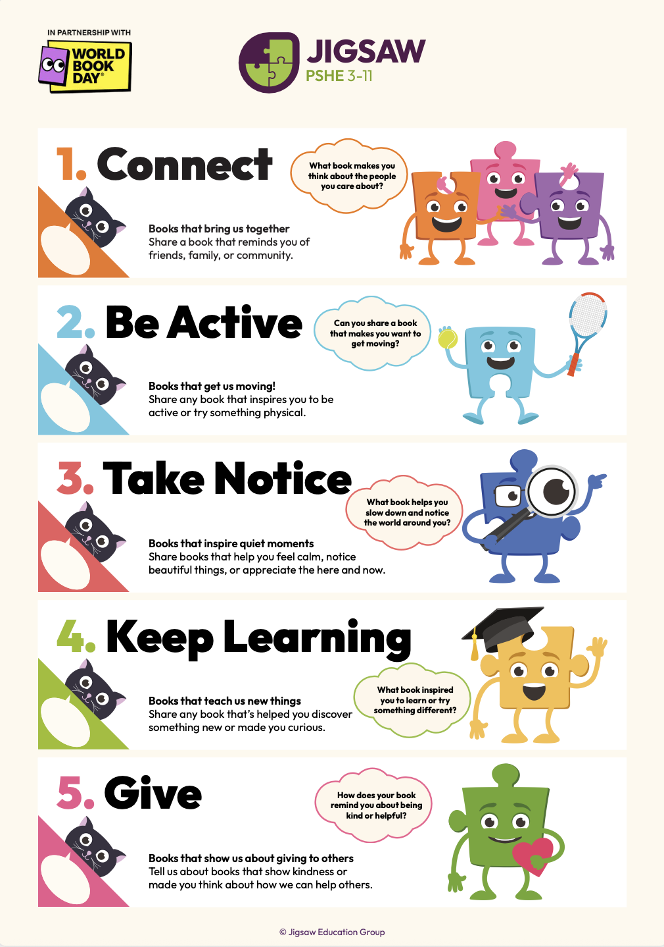
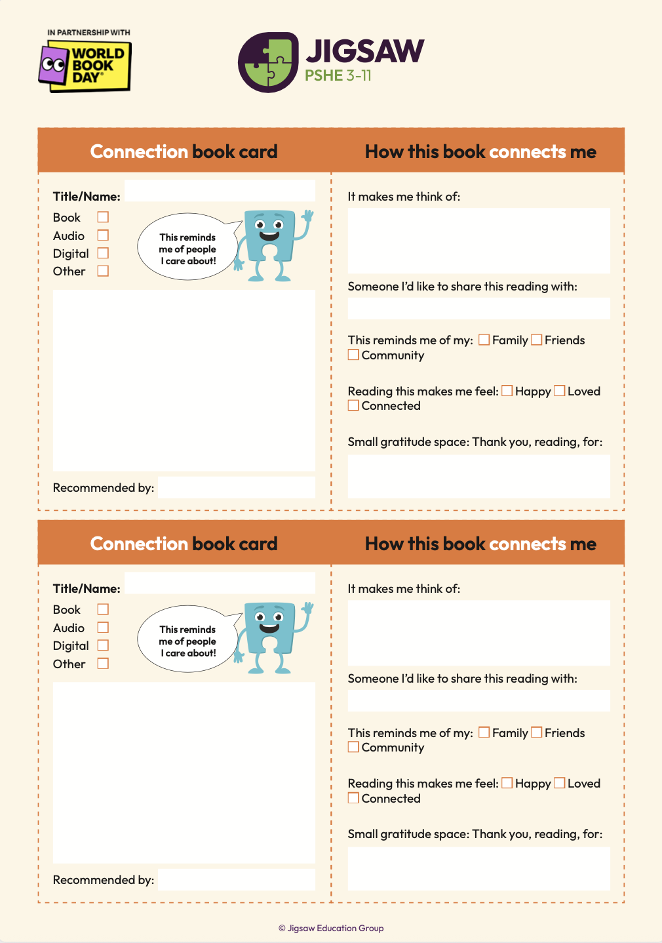
Jigsaw Education Wellbeing Book Swap
Jigsaw Education have put together a book-choosing session that connects with the 5 ways to wellbeing.
Notes:
Join in with our Jigsaw Book Swap to support reading for fun.
Teacher notes: This year, Jigsaw is inviting schools to come together with children, adults and families to share favourite books. Choose a book that you’ve enjoyed, bring it along, and swap your book idea for a different one that someone else has enjoyed.
Today we’re celebrating World Book Day in a special way - with our Jigsaw Book Swap!
When we think about how to take care of ourselves, we often talk about our wellbeing. Wellbeing means feeling good inside and out. Swapping books is one way of looking after our wellbeing, because books can help us feel calm, happy and inspired.
Everyone in our school - children and adults - can join in. All you need to do is choose a book that you’ve enjoyed, bring it along, and swap it for a different one.
When you find a book you really love, it can help you to…
Relax and feel calm
Learn new things about yourself and other people
Inspire new interests or passions
Can you think of a book that might help you…. to feel calm? Or learn something new?
By swapping books or our ideas, we will have the opportunity to discover new things to read. This may include books or other types of reading we may not have considered choosing for ourselves before. Because we are all different and have different interests, there will be lots to choose from.
Teacher notes: Jigsaw Education Group provides comprehensive whole-school PSHE programmes to support children’s social, emotional and mental health. Jigsaw has programmes for both primary (3-11) and secondary schools (11-16). For more information visit: https://jigsaweducationgroup.com/

Slide 28


Pupil Voice- Dressing up
Smart School Councils have created a debate for classrooms called “Is dressing up distracting from the main point of World Book Day?”
Notes:
https://www.worldbookday.com/resources/smart-school-councils-debate-activity/

Slide 29
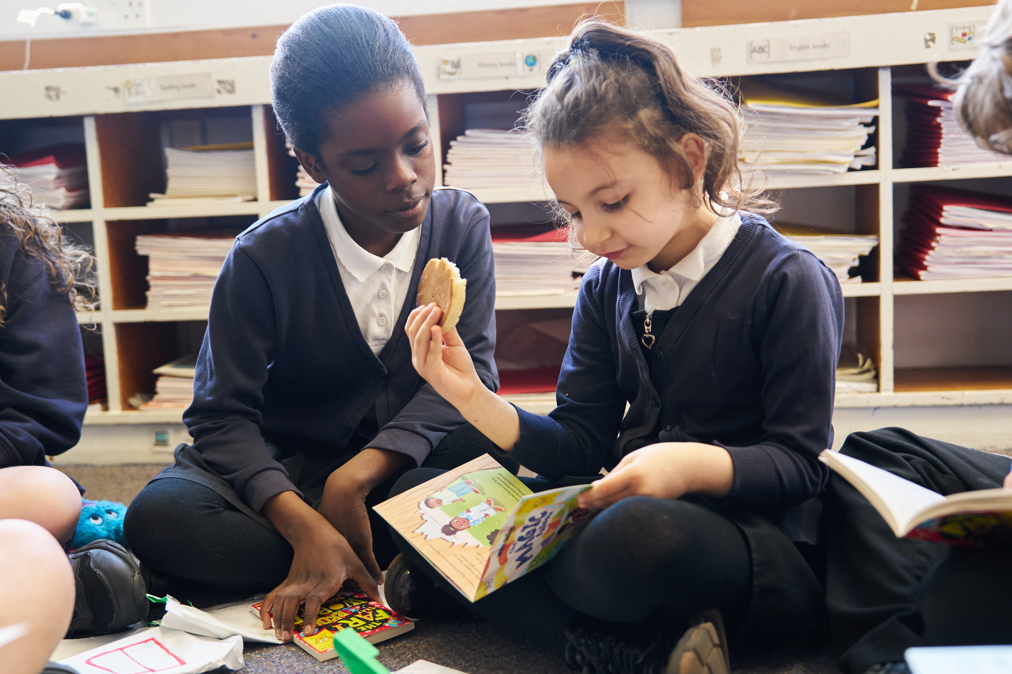

Breakfast and a Book: An opportunity to connect with your school community
In 2024 World Book Day partnered with Magic Breakfast to deliver breakfast and book gifting events. The initiative promotes literacy, generates enthusiasm for reading, and ensures no child starts the day too hungry to learn – a wonderful opportunity to celebrate books whilst providing a nutritious breakfast. This year we’re sharing the idea with everyone.
Notes:
Dress up a book instead of yourself and enjoy a breakfast bookswap. Find out how to run this activity here: https://www.worldbookday.com/resources/magic-breakfast-breakfast-and-a-book/

Slide 30

Thank you!
Any questions?
Contact us at: hi@worldbookday.com

