Slide 1





World Book Day 2026 5-11’s School Assembly
Subject/Theme: Reading for Pleasure
Look at the notes for script, links and further reading

Slide 2
Instructions for use
This PowerPoint is designed to help you Go all in for World Book Day in your primary school. Explore fun, fast-paced activities on the theme of reading for fun. Pupils will think about what makes something enjoyable, how reading can be a hobby, and ways to keep it fun when it feels hard. The aim is to spark “book talk” and build excitement about reading.
You can select which slides you use to curate your own World Book Day celebrations. For example, you might wish to use all the slides from start to finish in your World Book Day assembly. Or you might prefer to use some of the slides in your assembly and use other slides in lessons. We have also included introductory slides for Jigsaw Education’s Wellbeing activity LINK if you want to pick that route.
At the end of the pack, you will find ideas for follow-on activities linked to the central themes of the assembly which can be completed in classrooms.

Slide 3
Go All in for World Book Day!
Talk to the person sitting next to you about something you find fun

Slide 4

Did you know?
Notes:
To celebrate World Book Day, a £1 book voucher will be given to every child in the country, including you!
You can take your voucher to a bookshop or supermarket and exchange it for a brand-new book that has been written especially for World Book Day.
In our assembly today, we will be thinking about reading that we might choose to do for fun at home.
At the end of the assembly, we’ll have a sneaky peak at this year’s World Book Day books so you can think about which one you might like to buy with your £1 book voucher!

Slide 5

World Book Day 2026: Reading for Fun
What do we mean by the word FUN?
What do we mean by the word FUN?
Notes:
Happy World Book Day! Today we’re thinking about choosing to read for fun. But first — let’s think about fun itself!
You might want to prompt the children with questions like: Is fun always easy? Do you have to be laughing and joking when you’re enjoying something? For older children this could be a longer PSHE or Philosopical Enquiry lesson.
For younger children you might want to support with some images of things that are extreme fun like theme parks or parties or your World Book Day celebrations mixed in with some obviously work images and some quieter fun parks, home imagery (don’t include reading)

Slide 6
What do you find fun?
Turn to the person next to you.
In 30 seconds, tell them one thing you love doing for fun
Why is it fun?
Notes:
Most of the things we find fun are our hobbies – things we choose to do regularly, that make us feel good or interested. You might want to prompt with some feelings associated with fun: laughter, relaxation, pride
Could reading be a hobby too? Let’s see…

Slide 7

What is a hobby?
You choose to do it a lot–even every day
You do it without being told to
You think its fun even if you aren’t very good at it
You know you will get better if you practice
You find out ways to get better and even that can be fun
It might be something that you want to do in your future
It might be something that helps you forget everything else
Notes:
World Book Day have asked some children what hobbies are and they told us these things – take a vote – do you agree or disagree with these statements?

Slide 8

Could reading be a hobby?
Notes:
This year is the national year of reading and based on what children have said adults have designed this poster to suggest some ideas that connect reading to things you’re already interested in. Does this poster remind you of anything you like doing? Does it remind you of anything you like reading? Can you suggest any other icons or pictures that should be on this poster to suggest that reading could be a good hobby?

Slide 9

When reading is FUN (and when it isn’t…)​
Think-pair-share: Q. When is reading fun? Q. When can reading feel hard?
Talk for 30 seconds with your partner.
Remember: FUN doesn’t always mean easy —it means it feels worth it!
Notes:
E.g.
It’s FUN when… “I pick my own book,” “it’s funny,” “someone reads to me.” It’s HARD when… “the words are hard,” “it’s too long,” “I’m tired.”

Slide 10
What stops reading being fun?
Match-up these barriers to “fun” reading:
Barrier | Solution
I can’t find a book I like | Ask a friend or teacher for ideas
The words are tricky | Read with someone, or try audio
I get bored | Try a different topic or shorter story
I forget to make time to read | Make a “reading time” each day

Slide 11
Quick-fire Quiz!
Put your thumb up if you agree! 1. You can read anywhere. 2. Only novels count as ‘real reading’. 3. Comics, magazines, and recipes are reading too! 4. Reading can be about your hobbies.
5. Reading can be a hobby!
Remember: reading looks different for everyone! There is no right or wrong way to read. It’s how you feel.

Slide 12
What about our World Book Day authors. How do they have fun when reading?
Let’s find out!
Insert video clip or video link: How do authors have fun when reading?
Did they share any useful ideas, stories or tips?
Notes:
World Book Day have asked their 2026 authors to answer questions about their own reading: What is your top tip for enjoying reading? https://www.youtube.com/watch?v=wDuknRsqNsY&list=PL_hqLJPmFPSTACm7-X-4HP1io5QcLp54Z
Add a reflection after the chosen video Did they they share any useful ideas, stories or tips?

Slide 13

Design your dream day
Think about your most fun day ever, what would it look like? 1. Imagine a day full of your favourite things. What are they?
Notes:
This question is designed to get children thinking about the things they enjoy doing before connecting those to reading.

Slide 14

Notes:
Watch this video. The National Year of Reading is challenging us to try reading alongside some of the other things we love.

Slide 15
How could you go all in?
“I could read the description of my favourite film.”
“I could read a recipe for my favourite meal.”
“I could read to relax just before I go to bed.”
“I could read on the bus as I travel to my favourite place.”
“I could read to find out more about something I’m into.”
“I could read some tips for playing a tough level of my game”
Notes:
Thinking about your dream day, how could you add some reading of your choice in? If you want to pursue this planning angle then we have a resource which encourages children to build their own reading routines https://www.worldbookday.com/resources/my-reading-routine-a-pawprint-family-resource-2/

Slide 16












World Book Day 2026
Notes:
If you’d prefer to go down the Wellbeing angle this is a set of slides that introduces the wellbeing book swap to children that Jigsaw Education have designed in partnership with World Book Day.

Slide 17


Join our Jigsaw Book Swap!
© Jigsaw Education Group
Notes:
Join in with our Jigsaw Book Swap to support reading for fun.
Teacher notes: This year, Jigsaw is inviting schools to come together with children, adults and families to share favourite books. Choose a book that you’ve enjoyed, bring it along, and swap your book idea for a different one that someone else has enjoyed.
Today we’re celebrating World Book Day in a special way - with our Jigsaw Book Swap!
When we think about how to take care of ourselves, we often talk about our wellbeing. Wellbeing means feeling good inside and out. Swapping books is one way of looking after our wellbeing, because books can help us feel calm, happy and inspired.
Everyone in our school - children and adults - can join in. All you need to do is choose a book that you’ve enjoyed, bring it along, and swap it for a different one.
When you find a book you really love, it can help you to…
Relax and feel calm
Learn new things about yourself and other people
Inspire new interests or passions
Can you think of a book that might help you…. to feel calm? Or learn something new?
By swapping books or our ideas, we will have the opportunity to discover new things to read. This may include books or other types of reading we may not have considered choosing for ourselves before. Because we are all different and have different interests, there will be lots to choose from.
Teacher notes: Jigsaw Education Group provides comprehensive whole-school PSHE programmes to support children’s social, emotional and mental health. Jigsaw has programmes for both primary (3-11) and secondary schools (11-16). For more information visit: https://jigsaweducationgroup.com/

Slide 18
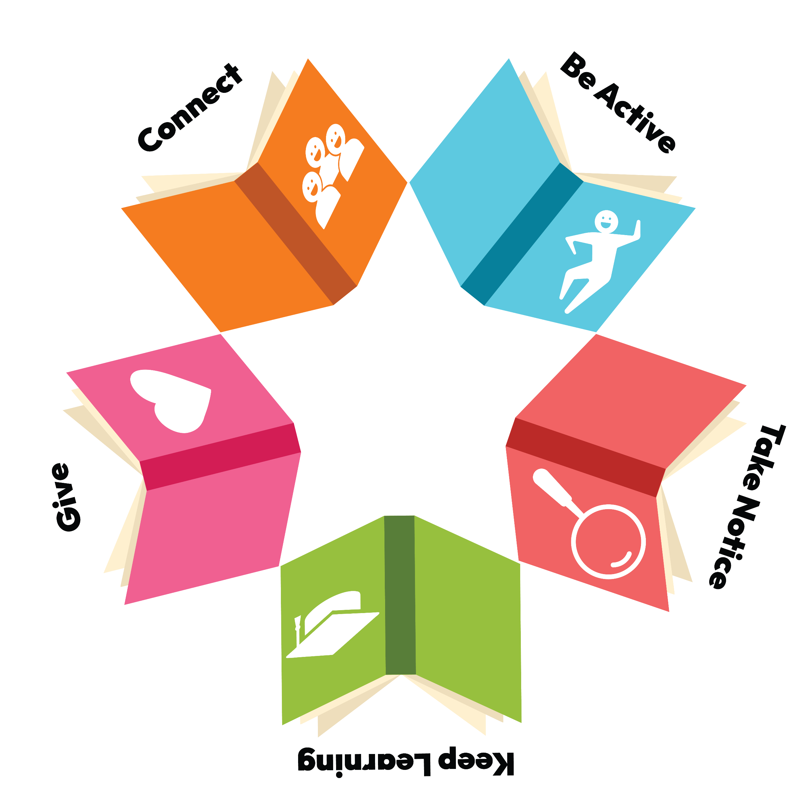


Books help us!
© Jigsaw Education Group
Notes:
Introduce Jigsaw Book Swap
Swapping books isn’t just about reading, it also helps us look after ourselves.
Ask children, how might reading a new book help to look after our wellbeing?
Draw out the different ways can support wellbeing, linking to each of the five ways to wellbeing, inspired by the NHS:
Connect - when we share a story, we connect and practice building positive relationships.
Be Active - when a book gets us moving we’re being active, which means looking after our physical health
Keep Learning - when we learn something new, we’re developing resilience and curiosity
Give to others - when we look out for and care for others, we show kindness and respect
Take Notice - when we notice little details, we’re taking notice. Just like when we use mindfulness in our PSHE lessons.
To find more about the Five Ways to Wellbeing, visit: https://www.nhs.uk/mental-health/self-help/guides-tools-and-activities/five-steps-to-mental-wellbeing/

Slide 19
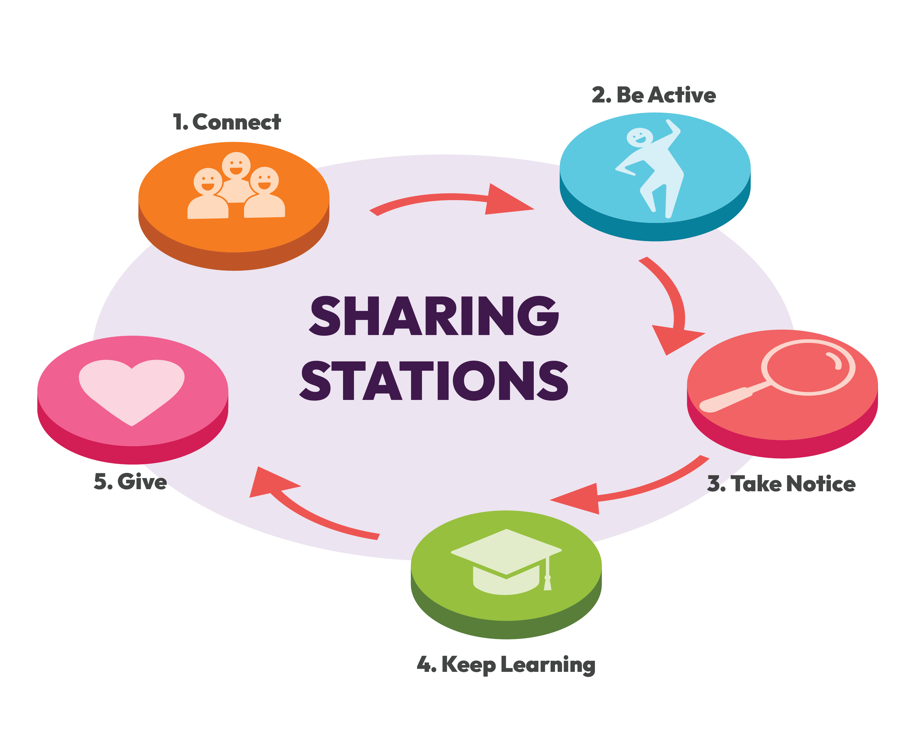

Choose something that you love reading!
ADD LINK TO JIGSAW RESOURCES
© Jigsaw Education Group
Notes:
How to Join In…
Do you have a favourite story? What is it about? Invite children to share thoughts with a partner.
Share a few ideas to show the range of books and different genres and highlight how these link to the NHS 5 ways for wellbeing themes – connect, be active, take notice, keep learning and give to others.
Choose a book that you love reading – this might be a book from home, or one at school in your library or classroom. At school, you’ll swap it for a different book that someone else has enjoyed.
You can also share your thoughts on a special Book Swap card to help others discover why your story is worth reading.
Together we’ll build a whole-school collection of exciting new books to enjoy.
Teacher note:
Taking part is completely free. Jigsaw has taken the hard work out, making the event simple
Visit… (put details here e.g. World Book Day Jigsaw Education Group page / or JEG website)
Children could bring a book from home or choose one from your school library. They’ll swap it for something different, and there will be special Book Swap cards to fill in for a fun way to recommend stories to each other.

Slide 20
What about our World Book Day authors? What are they challenging themselves to read? - Embed video here
Notes:
What do you want to read more of this year? https://www.youtube.com/watch?v=sJAeMmiea1E&list=PL_hqLJPmFPSSwFc1rLZaaOU2z6tc6bmCa

Slide 21

Which catches your eye?

Slide 22

Have a great World Book Day!

Slide 23
Suggested follow-on activities
1. “What is a hobby?” Sorting Game. Show pictures of different activities (playing football, baking, reading, painting, watching TV, etc.). Ask children to sort them into three baskets: “Fun things I do sometimes”; “Fun things I do all the time”; and “Things I never do.” Discuss reasons for choices. Prompt questions could include: “What makes something a hobby?”; “Can reading be one of those fun things we do regularly?” 2. “When Reading Feels Fun” Feelings Chart. Make a big poster with emoji faces (happy, calm, curious, tired, bored). Read aloud a short story or let children choose picture books. After reading, they place a sticker under the face that shows how reading made them feel. Talk about what made it feel fun (the story, the pictures, the characters, the quiet time). Help children identify what aspects of reading bring them pleasure. This activity can be done in a group or individually.
3. “My Reading Routine” Picture Plan. Children draw themselves reading somewhere outside school (in bed, under a tree, in the car). Prompt: “Where could you read for fun?” or “When might reading make you happy?” Build a class display called Our Reading Lives. Accompany with a short diary or sketch of the week where children think about when and where they can read for fun. How can they incorporate it into their day?
Notes:
This work builds on last year’s Overcoming Barriers to Reading for Pleasure series –still available which World Book Day and The Open University Delivered in partnership.
These conversations with practitioners share both strategic and tactical ways to engage with World Book Day and support delivery of a day that fits into a wider Reading for Pleasure framework
Planning World Book Day – where do you start? Will you dress up? What do you want the impact to be?
Engaging your school and wider community – including all staff, involving parents, author visits and community organisations
Delivery – practitioners discuss the implementation of ideas and how they went.

Slide 24
Suggested follow-on activities contd
4. Reading Time = “Me Time”. Create a 5-minute “Reading Me Time” where children choose anything to look at — picture books, comics, catalogues, magazines, recipes, scripts. Reflect afterwards: “How did that feel? What would make it even better next time?”
5. “Is Reading a Hobby?” Debate. Reflect critically on reading as a pastime. Split the class into two groups: Group A argues “Reading is a hobby.” Group B argues “Reading isn’t a hobby.” After sharing points, discuss what makes something a hobby (choice, enjoyment, frequency). End by asking: “If you wanted reading to become your hobby, what would help?” 6. “Reading Identity Collage”. Reflect on what kind of reader you are (or could become). Children make a collage with words and images that represent their reading life – what, where, how, and why they read (or want to read). Prompts: “What does reading mean to me?”; “When do I most enjoy it?”; “Who do I share it with?”. 7. “Barriers and Motivators”. Identify what gets in the way of reading for fun, and how to fix it. On one side of a page, children list or draw barriers (too tired, can’t find a book I like, no time, too hard). On the other side, they brainstorm solutions (try a new genre, audiobooks, read with a friend, comfy reading spot). Make a class “Reading Motivators Wall.”
Notes:
This work builds on last year’s Overcoming Barriers to Reading for Pleasure series –still available which World Book Day and The Open University Delivered in partnership.
These conversations with practitioners share both strategic and tactical ways to engage with World Book Day and support delivery of a day that fits into a wider Reading for Pleasure framework
Planning World Book Day – where do you start? Will you dress up? What do you want the impact to be?
Engaging your school and wider community – including all staff, involving parents, author visits and community organisations
Delivery – practitioners discuss the implementation of ideas and how they went.

Slide 25
Suggested follow-on activities contd
8. “Reading as my Hobby” Passport. Give each child a mini “Reading Hobby Passport.” Pages could include: “My favourite place to read”; “A book I couldn’t stop reading”; “A time I chose reading instead of screen time”; “My next reading goal”.
9. “Design a Reading Hobby Club”. In small groups, children design a club that celebrates reading as a hobby: What would members do?; How would they make it fun?; What kinds of books or challenges would they include? 10. “My Reading Future” Reflection. Children write or draw: “In five years, I’ll still be reading because…”; “Reading will be my hobby because it makes me feel…”.
Resources prepared by SHAPES for Schools | www.shapesforschools.com
Notes:
This work builds on last year’s Overcoming Barriers to Reading for Pleasure series –still available which World Book Day and The Open University Delivered in partnership.
These conversations with practitioners share both strategic and tactical ways to engage with World Book Day and support delivery of a day that fits into a wider Reading for Pleasure framework
Planning World Book Day – where do you start? Will you dress up? What do you want the impact to be?
Engaging your school and wider community – including all staff, involving parents, author visits and community organisations
Delivery – practitioners discuss the implementation of ideas and how they went.

