Slide 1




World Book Day 2026
11+ School Assembly
Subject/Theme: Reading for Pleasure
Look at the notes for script, links and further reading

Slide 2
Instructions for use
This PowerPoint is designed to help you Go All in this World Book Day in your secondary school. Discover quick, engaging prompts that get students thinking about reading for fun and what makes it meaningful. Activities explore hobbies, barriers to reading, and how to reconnect with books that fit real interests. The aim is to inspire discussion and a fresh sense of enjoyment in reading.
We have also included introductory slides for Jigsaw Education’s Wellbeing activity if you want to pick that route.
You can select which slides you use to curate your own World Book Day celebrations. For example, you might wish to use all the slides from start to finish in your World Book Day assembly. Or you might prefer to use some of the slides in your assembly and use other slides in lessons.
At the end of the pack, you will find ideas for follow-on activities linked to the central themes of the assembly which can be completed in classrooms.

Slide 3

Notes:
To celebrate World Book Day, a £1 book token will be given to every young person in the country, including you!
You can take your token to a bookshop or supermarket and exchange it for a brand-new book that has been written especially for World Book Day.
In our assembly today, we will be thinking about reading in our own time.
At the end of the assembly, we’ll have a peak at this year’s World Book Day books so you can think about which one you might like to buy with your £1 book token!

Slide 4

Introduction
World Book Day 2026: Reading for Fun!
Happy World Book Day! Today we’re thinking about what makes reading fun.
But first – let’s think about fun itself!
What does FUN mean to you?

Slide 5
What is fun?
Consider with a partner:
Q. What makes something fun?
Q. Does fun always have to be easy?
Try to use the words below in your discussions:
choice challenge connection creativity reward
Notes:
Most of the things we find fun are our hobbies — things we choose to do, that make us feel good or interested.
Is there a difference between easy fun and satisfaction – what is it? Invite students to reflect on things they go back and back to - sport, drama, video games – what helps them get past something being difficult,
Fun usually happens when we choose to do something, it matches our interests, and we feel good at it or curious about it.

Slide 6
Plan your ideal day
Imagine your dream day, what would it look like?
1. Imagine a day full of your favourite things. What are they?
Notes:
Reflect – are you reading already – are you looking up hacks, scrolling fan fiction, listening to an audiobook – could you add reading in anywhere – where could reading take you deeper into something you love or what to find out more about.

Slide 7
Can reading be fun or a hobby?
“Reading can be a hobby too — if it connects with you.”
Do you agree?
Remember: It doesn’t have to be novels — it could be manga, blogs, sports pages, articles, even song lyrics. If it grabs you, it counts.
Notes:
Consider:
You can read about your interests
You can get lost in a good story
You can learn something new
You can relax and escape

Slide 8

Notes:
Watch this video. The National Year of Reading is challenging us to try reading alongside some of the other things we enjoy doing. What do you think?

Slide 9

How could you Go All in?
Q. How can reading fit into what you already love?
Gaming → reviews, lore, fan fiction
Sport → player biographies
Music → lyrics, interviews
Fashion → blogs, design books
Art → comics, manga
Food → recipes
Notes:
Remember: When reading connects with your world, your in charge and it can feel more fun.

Slide 10
Consider what might stop reading feeling enjoyable
Pair task:
List two times when reading was fun.
List two times when it wasn’t.
What made the difference?
Notes:
For example:
Take some ideas from students and try and group them. In World Book Day’s work with young people the examples would be:
Choice and connection make reading fun.
Pressure and confusion take it away.
Invite students to reflect on whether it’s changed as they have got older, whether they are or aren’t reading because it’s enjoyable or not or for other reasons. Does being told it’s fun help? What would be more useful?

Slide 11
What about our World Book Day authors. How do they enjoy reading?
ADD LINKS TO YOUTUBE VIDEOS YOU WANT TO USE
(INSTRUCTIONS ARE IN THE NOTES SECTION BELOW
Notes:
World Book Day have asked their 2026 authors to answer questions about their own reading:
Where is your favourite place to read?: https://www.youtube.com/watch?v=lf9-fha8HFg&list=PL_hqLJPmFPSTbYr1q4mJ5099GHyx2vj7Y
What do you want to read more of this year? https://www.youtube.com/watch?v=sJAeMmiea1E&list=PL_hqLJPmFPSSwFc1rLZaaOU2z6tc6bmCa
What is your top tip for enjoying reading? https://www.youtube.com/watch?v=wDuknRsqNsY&list=PL_hqLJPmFPSTACm7-X-4HP1io5QcLp54Z
What children’s books have you enjoyed in the last year? https://www.youtube.com/watch?v=k8HxgJYCLyM&list=PL_hqLJPmFPST2yvfg80ste5Sea1V8VhhF
Add a reflection after the chosen video Did they they share any useful ideas, stories or tips?

Slide 12
Envisioning your future
What are you into?
What will your evenings look like?
How will you look after yourself physically and mentally?
What will your room be like?
Notes:
As you get older you are shaping the person you are going to be beyond school – what do you want that person to be like? There won’t be teachers and parents bossing you about so you’ll have the space to choose. In a world where you are in charge what are the barriers to your reading? Can you imagine reading fitting into this version of yourself? – what will you need to find out about?

Slide 13
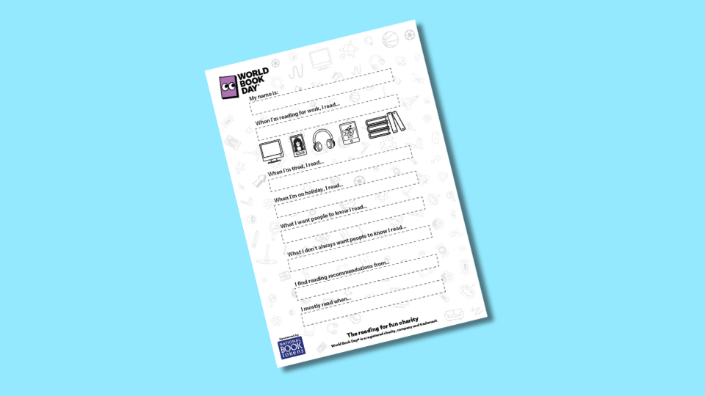
Find out about your teachers’ reading identities
Notes:
If you have staff that are up for it this would be a great place for them to share their reading identities and how they include reading either as a discrete hobby OR as part of doing other things –try to have a mix of keen and less keen. The door poster is here https://www.worldbookday.com/resources/staff-reading-door-poster/.
As you go round school today take look at the door posters and see whether you connect with any of these adult and independent reading identities
Reflect- who in school can support us to connect reading with our future ambitions? Mention libraries and other support services.

Slide 14
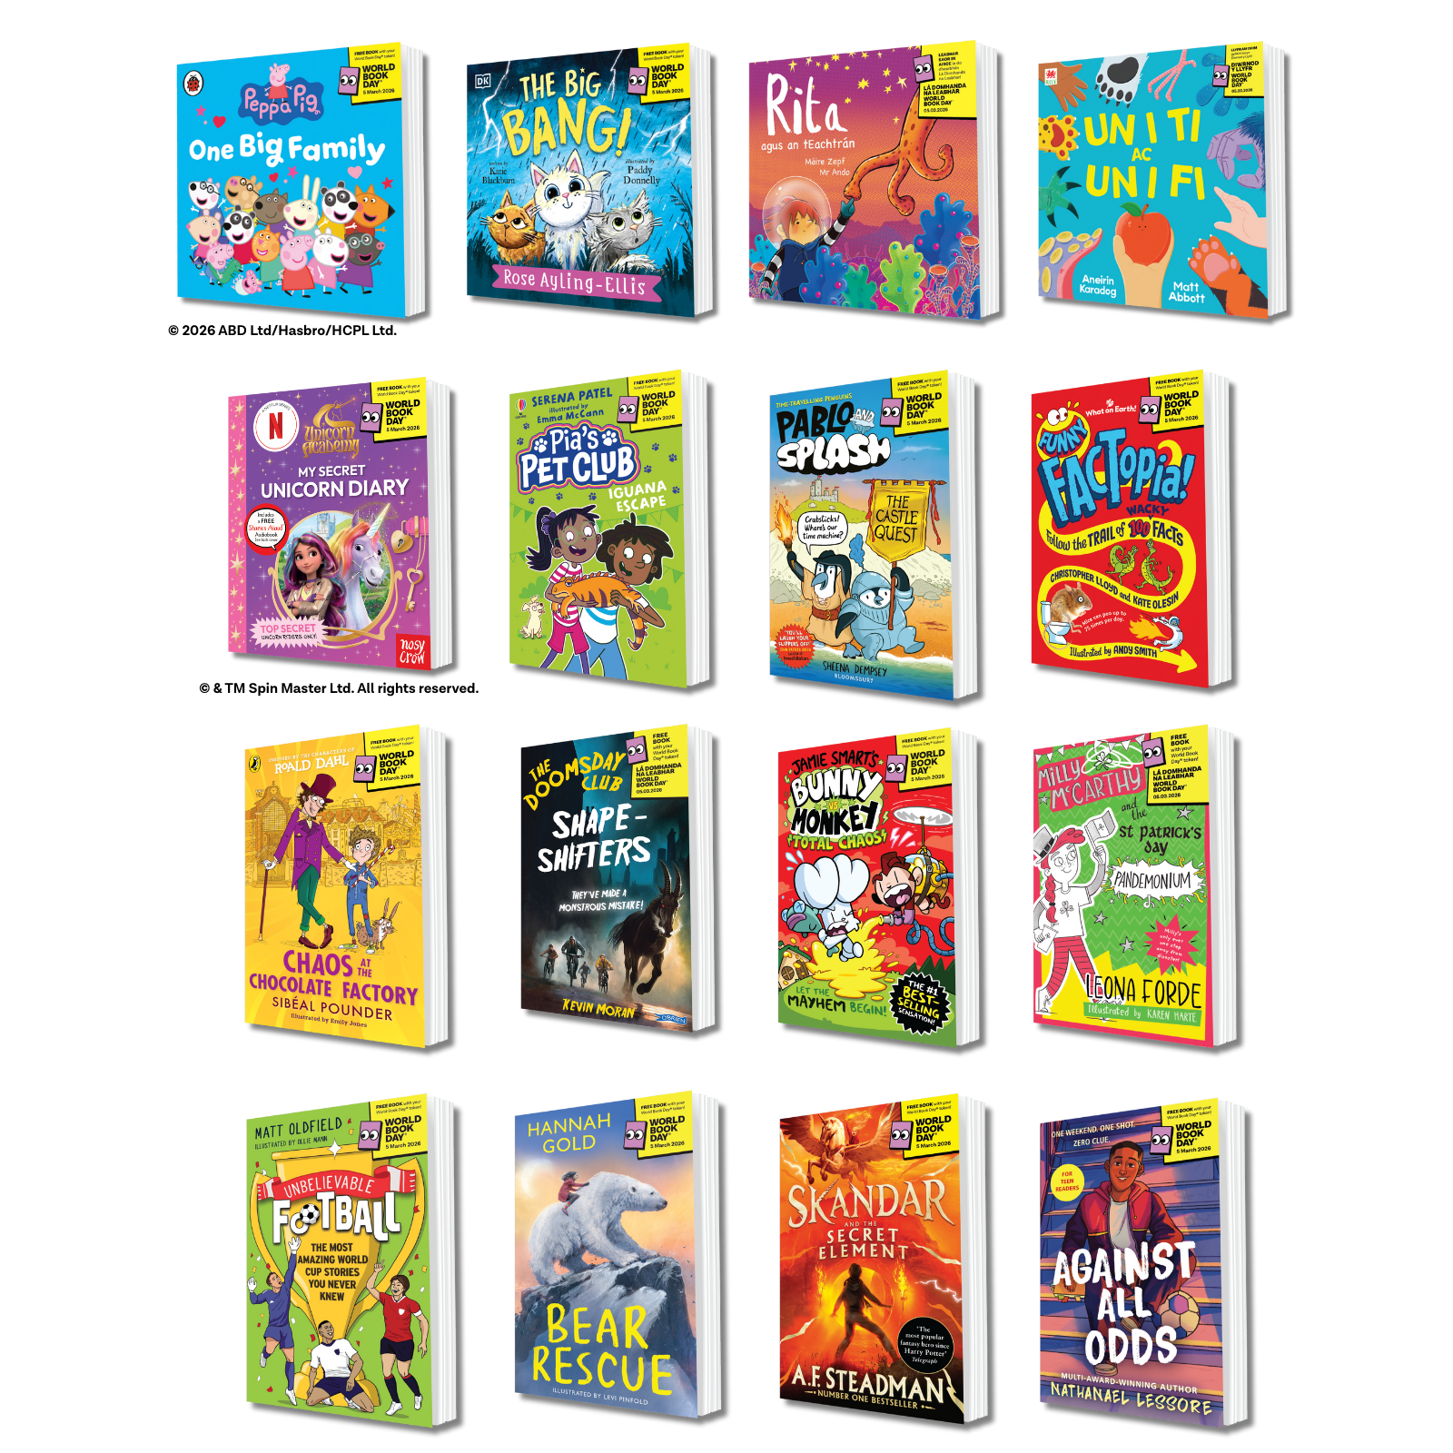
This year’s World Book Day Books
Maybe you’ll choose on of this year’s World Book Day books?

Slide 15
Suggested follow-on activities
1. “What Counts as a Hobby?” Discussion Sprint. Challenge assumptions about what counts as a hobby and where reading fits. Ask students to jot down 3–5 of their hobbies. In small groups, discuss: What makes something a hobby? (Choice, time, enjoyment, community?); Does reading fit those criteria for you personally? Why or why not? Share key insights as a class.
2. “Reader or Not?” Debate. Label one end of the room “Reading is one of my hobbies” and the other “Reading is just something for school.” Read a few statements and let pupils move physically along the line to show agreement: “I’d read for fun in my spare time”; “Reading helps me relax”; “I never know what to read”; “I don’t have time to read”. Discuss what influences their positions and what might move them toward the “reading as hobby” end.
3. “Barriers & Motivators” Mapping. Identify personal barriers to reading for fun, and practical solutions.
On a two-column sheet, students list: Barriers: “No time,” “Too many distractions,” “Can’t find books I like,” etc.; Solutions: “Set a 10-minute reading window,” “Try audiobooks,” “Ask a friend for a rec,” “Find a comfy reading space.” Create a class “Reading Motivators Wall.”

Slide 16
Suggested follow-on activities contd
4. “My Reading Identity” Profile. Students complete a “Reading Identity Card” with prompts such as:
I last read ___ (and it was…); I prefer stories that make me feel ___; I like to read (format: e.g. books, fan fiction, manga, articles, social media posts…); Reading feels like ___ to me; Reading could become a hobby if…
5. “Why People Read” Gallery Walk. Explore the emotional and social benefits of reading. Around the room, display quotes from diverse people (authors, athletes, influencers) about why they read. Examples: “Reading gives me a world that’s all mine”; “It helps me escape stress”; “Reading makes me a better creator”. Students walk around, note any that resonate, and add their own reasons to sticky notes.
6. “If Reading Were a Sport…” Creative Challenge. Reframe reading as an active, skill-building hobby. Ask: “If reading were a sport or hobby club, what kind would it be?” Prompts: What would training look like? What would ‘levels’ or ‘tournaments’ be? Who would be your teammates or coaches? Groups design a short pitch or poster for their imagined “Reading Club.”
7. “Reading Routine Reboot”. Challenge pupils to choose a personal reading slot for the next week (e.g. “10 minutes before bed,” “on the bus,” “during lunch”). Provide a small log or phone wallpaper reminder.
Reflect a week later: What worked? What didn’t? Did reading feel different when you chose it?

Slide 17
Suggested follow-on activities contd
8. “Bookless Reading” Discussion. Expand ideas about what counts as reading. Ask: “Can you be a reader if you don’t read books?” Discuss forms like: online articles, fan fiction, graphic novels, audiobooks, podcasts with transcripts, blogs, gaming lore, etc. Reflection: “If we count those, are more of us already readers than we think?”
9. “Reading for Real Life” Connections. Students pair up to share one thing they want to get better at or one passion they have. Ask: “What kind of reading could support or inspire that?” (articles, biographies, instructions, guides, fiction that explores similar themes). Create a class “Reading for Life” wall showing how reading feeds personal goals.
10. “My Reading Future” Reflection. Prompt students to finish sentences like: “In five years, I’ll be reading because…”; “Reading will still matter to me when…”; “Reading helps me feel…”. Optional: Create a class time capsule or digital display.
11. “Reading as Self-Care” Workshop. Explore how reading can reduce stress, boost focus, or create calm. Try a short “reading for relaxation” session with soft music and low lights, then reflect on how it felt.
Resources prepared by SHAPES for Schools | www.shapesforschools.com

